Slide 1
WIMS Challenge review
Or “Oh, that’s how I could have done it”

Slide 2
you notice a strange and out of place little button on the dashboard

Slide 4
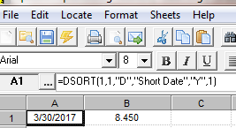
On the date where influent flow was the highest this year (Using Reports)

Slide 5
On the date where influent flow was the highest this year (Using Graph)

Slide 6
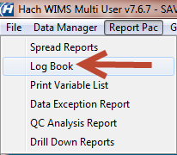
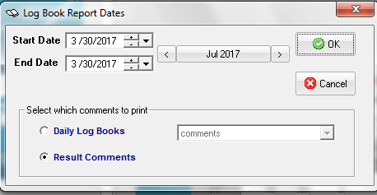
Viewing the result comment for var# 901 (rainfall)

Slide 7
Use MDE or cde to enter value for zinc

Slide 8
Day when nickel > than silver

Slide 9
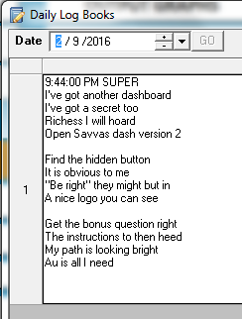
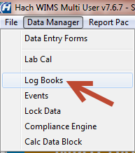
Logbook entry on feb 9th 2016

Slide 10
Open savvas dash version 2

Slide 11
Hidden button, be right, logo

Slide 12
Answer the bonus question

Slide 13
Open new-riches.xls, copy

Slide 14
Paste into import riches mde

Slide 15
Open npdes sheet 2, put in key 1&2

Slide 16
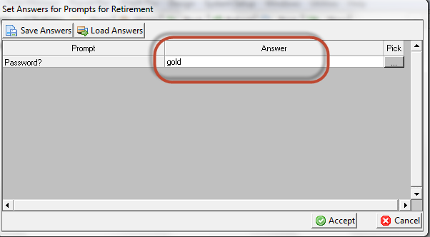
Retirement option on dashboard

Slide 17
Correct prompt answer of gold leads to where savvas documents how she has been able to collect gold from the influent

Slide 18
Dashboard button to claros

Slide 19
Primary clarifiers, review, note

Slide 20
The end?

