Slide 1
SGW WIMS Task Management Solution
Murray Leech
WIMS / SCADA Project Officer
South Gippsland Water
2017

Slide 2
South Gippsland Water
SGW manages 10 WTP’s over a large geographical area
The treatment plants are operated and managed by: 8 WTP operators, 2 area supervisors and 1 quality manager.
Operators will rotate across a number of plants and may visit more than one plant per day to cover other staff and complete more complex work such as filter inspections.
In addition to ensuring quality standards operators are also responsible for a significant amount of maintenance and improvements works at each of the plants.
And without a well developed work management system operators are required to work with little guidance on the work required for the plant.

Slide 3
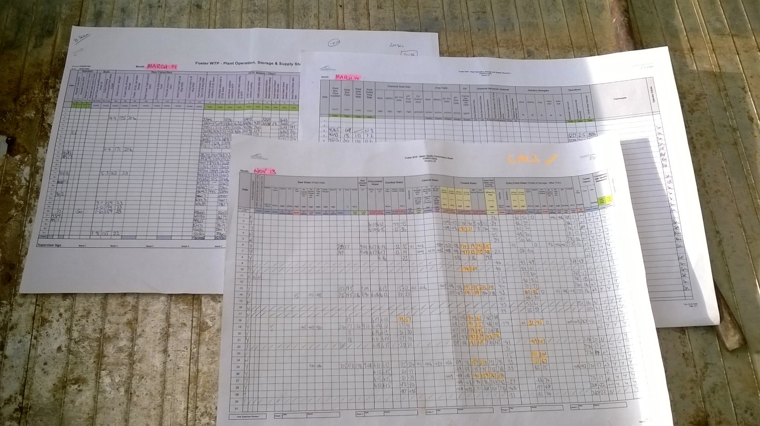
Initial Operator Forms
SGW initially started building water quality reports to match existing paper forms
These reports allowed operator to easily see past data and which tests required attention

Slide 4
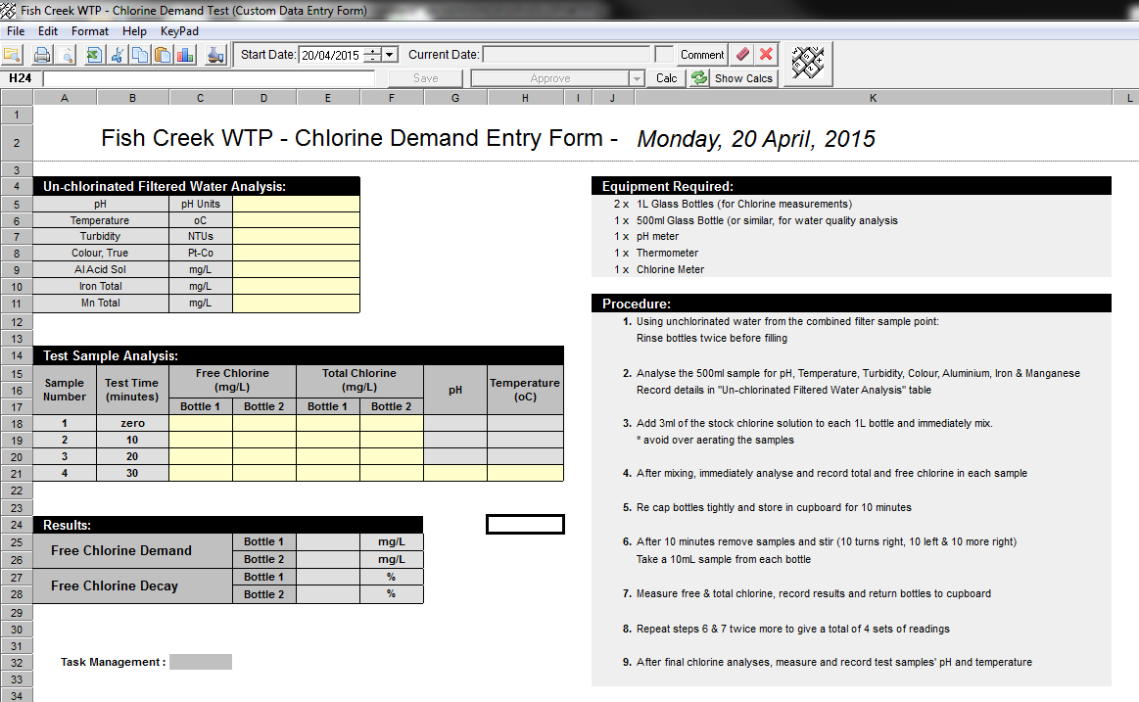
Daily and investigation forms
SGW also produced a number of more complex daily forms for tests like Cl2 demand, jar testing and chemical delivery.
Although we were really happy with these forms we found it difficult to ensure all operators were using them as frequently as we wanted them to.
When someone would go looking for data it often wasn’t there
It also took a significant amount of time for supervisors to ensure data was entered and to explain where to find the form and what needed attention

Slide 5
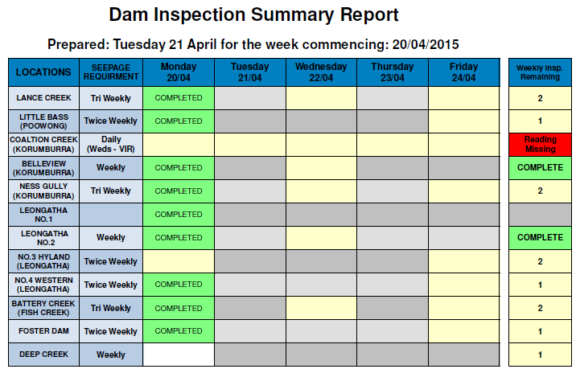
Reporting on critical data entry
To ensure critical data wasn’t missed we built a number of scheduled reports to alert operators and supervisors that work was missed.
But these reports only provided information at points through the day.

Slide 6
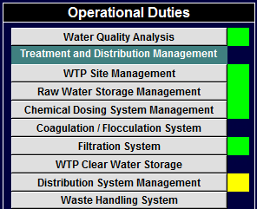
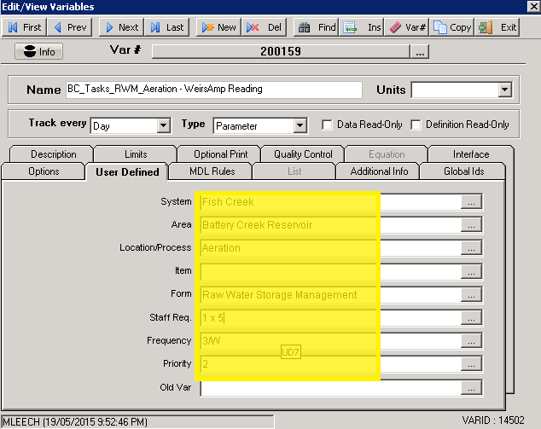
Building a Task Management Solution
To give operators an indication of where work is required we added coloured indicators on all dashboards to show where tasks were required either today (green) or by the end of the reporting period (yellow).
This was accomplished by utilising the user defined fields of each variable along with some fairly basic SQL queries

Slide 7
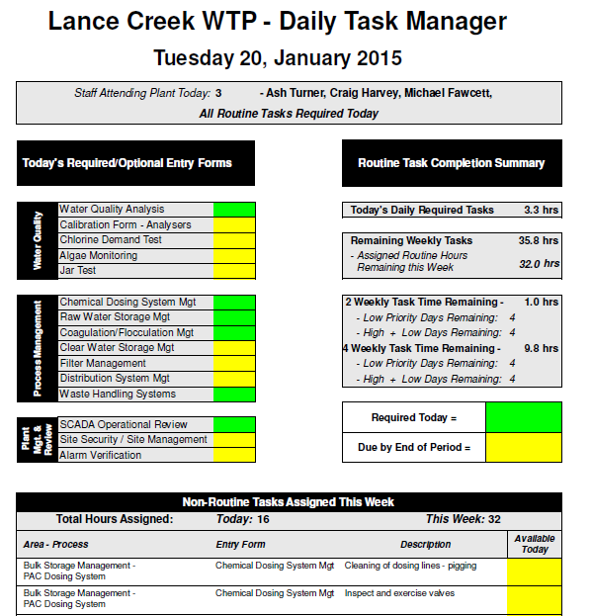
Work Summaries
This work not only gave allowed operators a more efficient way to find there work
By modifying the SQL queries we could also produce summary information on the progress of work completed as well as daily reports of the work required

Slide 8
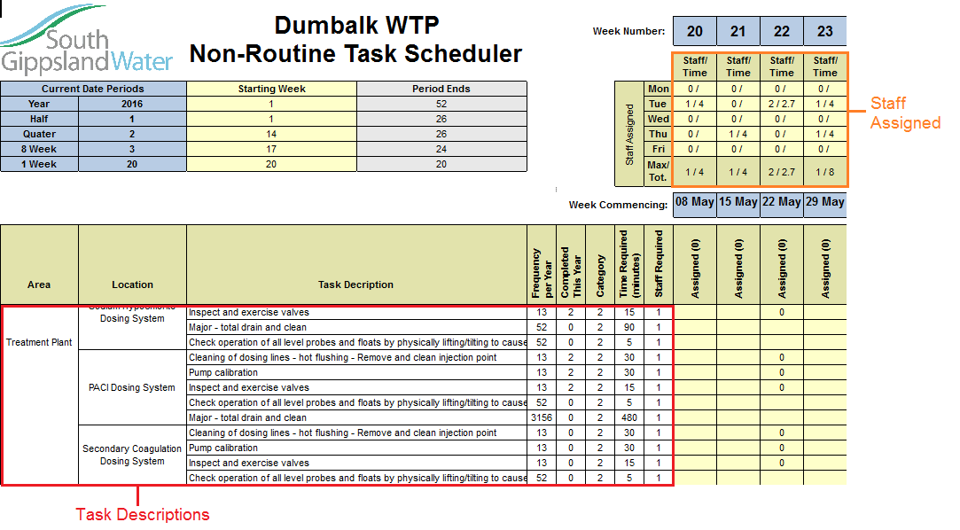
Operator Management
With a number of larger tasks to be completed throughout the year supervisors requested a way to manage staff to facilitate the work.
This led to the inclusion of non-routine task scheduling and staff assignment to adequate ensure resources could be planned to complete these jobs.

Slide 9
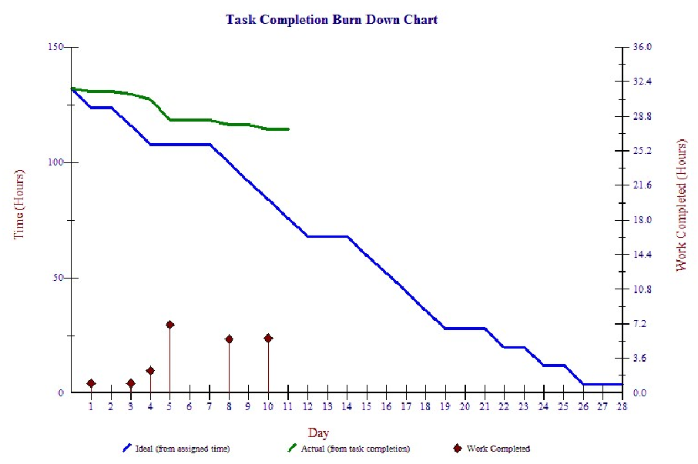
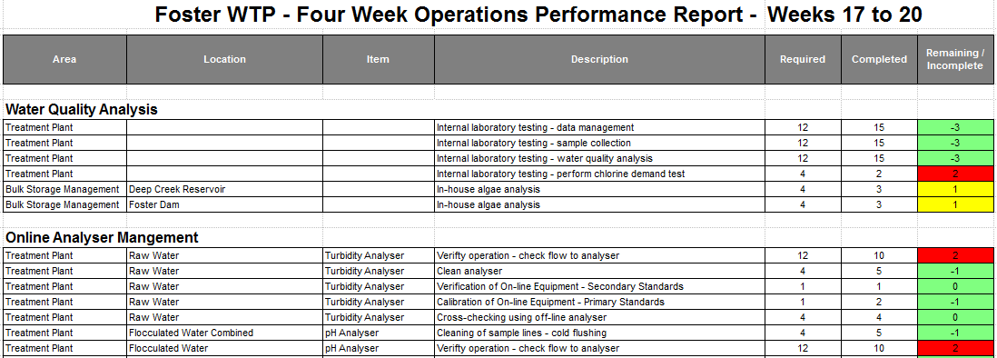
Completion Reporting
Putting all the data together managers and supervisors are now able to report on the efficiency of operators and ensure that all required work was completed for a given reporting period.

Slide 10
Results
Supervisors can now track which plants and tasks require more attention and through better reporting operators are more accountable when work is missed
Operators were almost unanimously pleased with the system. It allows them to retain decision making about their work but lets them know which items still require attention.
The entire system was produced and rolled out in around 12 months with limited resources (1 part time), for a significantly small cost and no additional system resources
There has been a dramatic improvement in the level of data collected ensuring reporting is more accurate and time is not wasted tracking down data.
As a custom addition there is no external support to maintain the system and it is heavily dependent on existing resources and documentation for its continued use and development

