Slide 1
General Session – River Birch A & B Tuesday 10:45AM – 12:00PM Introducing Data Interoperability - Interfacing Best Practices Scott Dorner – IIM Product Manager, Hach

Slide 2
Interfacing 101 -SCADA
SCADA Interfaces
Connect to SCADA Historians, summarize data and store summaries in WIMS Database
Interfaces to Wonderware, GE, Rockwell, OSI Pi…
Included in your license Q12933 CSV (AKA FREE!!!)
http://www.opssys.com/instantkb/article.aspx?id=12932

Slide 3
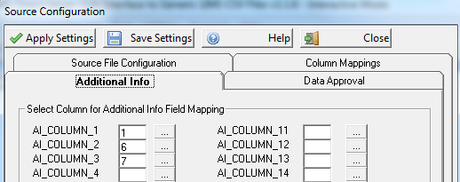
Interfacing 101 - LIMS
LIMS Interface
Connects to LIMS and transfers results
Typically gets data that has changed since last run
Additional Info support for Sample Numbers, MDL…
Included in your license Q12351 CSV (AKA it’s FREE too!!!!)
http://www.opssys.com/instantkb/article.aspx?id=12932

Slide 4
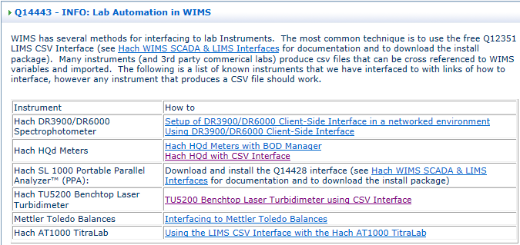
Interfacing 101 - Instruments
Instruments
If it produces a CSV we can probably get the data.
DR3900, HQd,SL1000 PPA, AT1000 TitraLab
http://www.opssys.com/InstantKB/article.aspx?id=14443
http://www.opssys.com/instantkb/article.aspx?id=12932

Slide 5
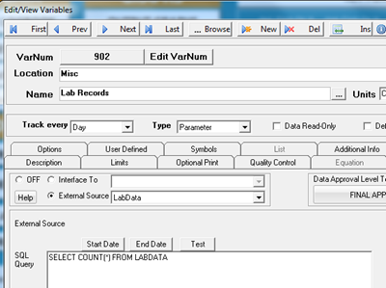
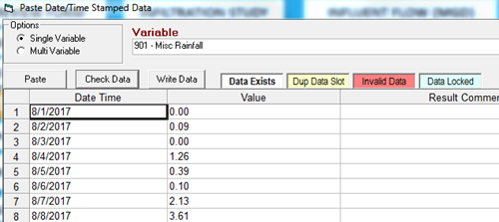
Interfacing 101 – Other tricks
Get Data from External Systems
+

Slide 7
What’s coming in 7.6.6
Security Templates
Security Template holds User Type, Group Security, Data Approval Level and preferences.
Users can be assigned to templates making it easier to maintain security
Custom Data Entry will allow Lab Cal / Additional Info data to be entered.
Enter Analysis Times, Sample Time, Sampled By in Lab Cal.
Customizable messages for Entry Limit Exceedances.
Feature Request Forms
Notes:
In today’s 4PM session we will cover the vision of our software platform and get your feedback on your key problems and point points that you are trying to solve.
In Thursday’s 4PM session our UX team will have some activities to help us better understand how you use WIMS and ways we can improve it.

