Slide 1
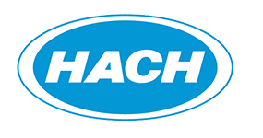
Notes:
Good morning, welcome, and thank you for the opportunity to meet with you for a few minutes.
This is a great event planned for this week, and on behalf of Hach leadership, we truly appreciate the relationships that we have built with each of you and the sense of community that you have helped foster that makes this event possible.

Slide 2
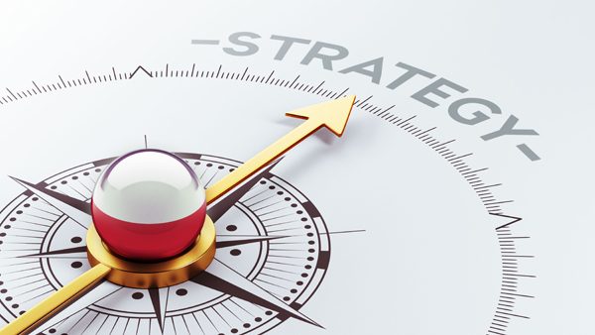
Notes:
In many ways, WIMS was Hach’s first true software offering, and in many ways it has influenced the strategy of software within our business.
WIMS, both as a product and as a community, has established a model for how Hach seeks to engage our user community.
WIMS has influenced how Hach works to bring tangible solutions to industry uncertainty.
WIMS has influenced how Hach views and talks about software within the walls of our own business.
This is important, because Hach has a rich history with our origin being born from applying chemistry to water analysis practices. We have evolved with a diverse offering of products, chemistries, services, and expert advice to help you with your water analysis.
And, software solutions are a key component to our future strategy, which really is something that was unthinkable when I started working here over 20 years ago.

Slide 3
Software is a keystone to hach’s future
Our Mission
Our Vision
Strategic Statement
Ensure water quality for people around the world.
We make water analysis better - faster, simpler, greener and more informative - via unsurpassed customer partnerships, the most knowledgeable experts, and reliable, easy-to-use products.
Deliver expert answers, outstanding support and improved decision-making with connected instruments, software and applications insight.
Notes:
Inside the walls of our business, my colleagues and peers share a mission, a vision, and a strategy.
And, we talk about it daily, using the exact words that are represented on this slide.
CONSIDER READING OUT LOUD TO REINFORCE TO AUDIENCE.
You will notice that software is explicitly stated in Hach’s strategic statement.
I am hear to tell you that without a doubt, software is a strategic initiative and keystone to Hach’s future.
Today, I want to touch on our software vision. And, the fact that you are here this week, as a group, as a community, talking about WIMS absolutely reinforces the importance of software to Hach.

Slide 4
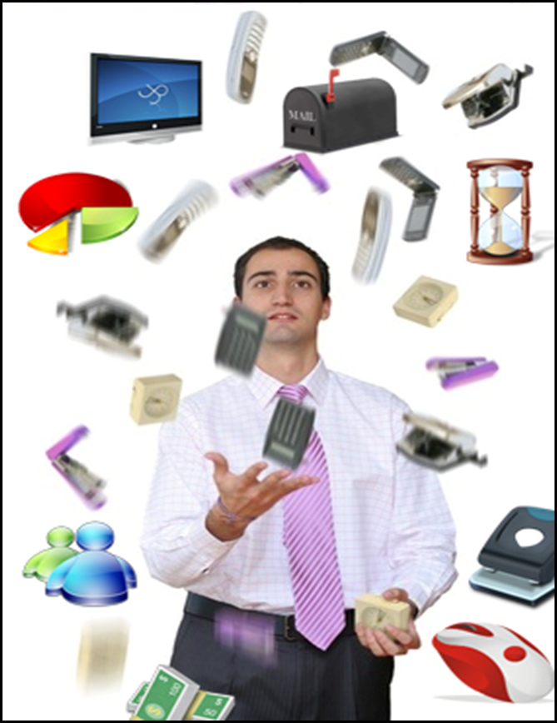
The Uncertainty of today
Notes:
Today, your daily work may be full of uncertainty.
There’s manual processes from past and existing work where important data, measurements, and workflows are still recorded using pencil and paper. Unfortunately, paper is lost, handwriting is hard to interpret, and work can be slowed trying to find that colleague who was responsible for a specific action.
These data are then managed in various forms, at disparate locations, and often have to be manually entered into a spreadsheet that may live outside of a central network directory.
All of this can add up to poor maintenance and management practices that could lead to high operating expenses, unreliable facilities, and regulatory fines.
The world of uncertainty is not a place where we want to live.

Slide 5
the clarity of today
Notes:
Let’s face it, we now live in a world where uncertainty can be avoided.
Technology, devices, data, communication are all in the palm of our hands on an hourly basis, if not more frequent than that.
Yes, you have traditional practices, and, yes, you want your operators to walk around the plant.
Today, digital data can be collected, analyzed, and transformed into actionable insights to drive better decision making, better visibility, and more efficient plant operations and reporting.
Sounds good, right?

Slide 6
Data Management
Device Management
Process Management
Notes:
If I simplify this discussion, really it can be organized into three themes:
Data Management
Device Management
Treatment Management
Data Management is the organization and analysis of data collected from the field, data being monitored inside the plant, data that is important to interpret and report to ensure that your plant meetings regulatory compliance.
Device Management is the practice of ensuring that your Hach probes, sensors, analyzers are properly maintained, that you are working proactively, rather than reactively. Device Management is driving the health and operations of your plant.
And, Treatment Management is where this all comes together to ultimately lead to efficient and effective plant management through optimization and smart processes.

Slide 7
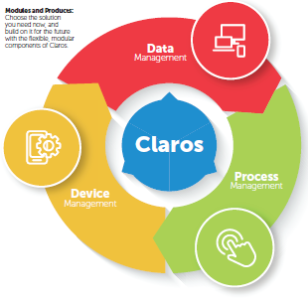
What does claros mean for you?

Slide 8
WELCOME TO THE
Power of Clarity
Now, turn your data into powerful operations insights. Get greater certainty in your decisions and unmatched control of costs and compliance.
Notes:
Welcome to the power of clarity!
Lets turn your data into powerful operational insights!

