Slide 1
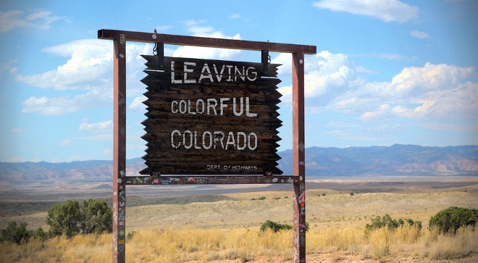
WIMS National User Conference – wrap up
Barry Lyon
VP, Global Marketing
Notes:
Quick self introduction
First off, Thank you for taking time out of your busy schedules to come together for a couple of days to learn, share, and connect.
Round of applause for our presenters. . .thank you so much for sharing your knowledge and experience with your peers and with the Hach team
Take a moment to thank the Hach team who’ve worked with each of you this week, and a special thanks to Pam Moss and Bryan Sharpnack

Slide 2
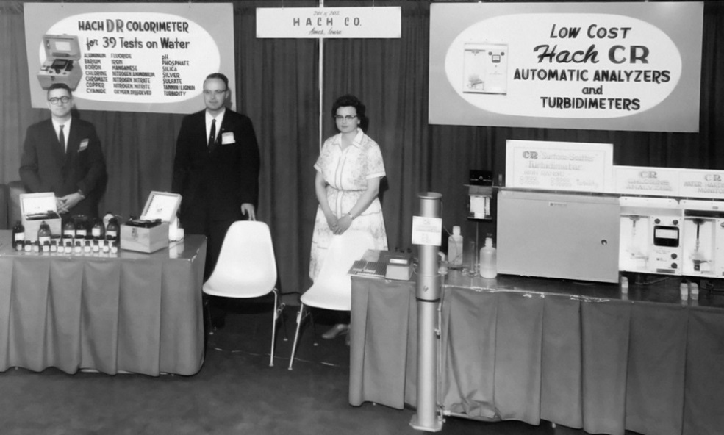
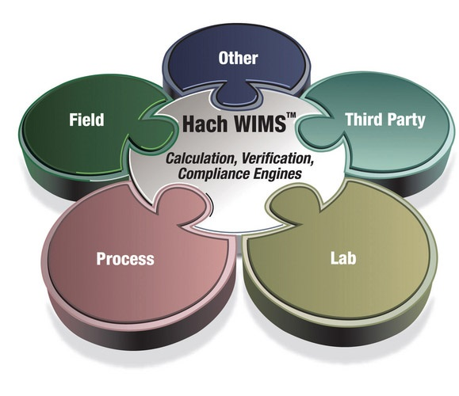
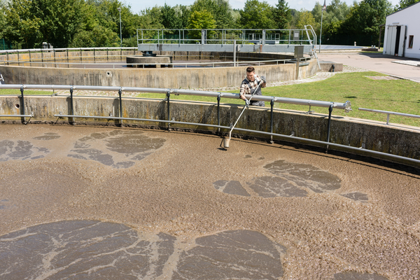
Innovation → Actionable Insights
Measurement:
Faster, Simpler, Greener, More Informative
Understanding:
Actionable Insights:
Notes:
As active users of WIMS, your community is helping us continue to innovate, so I want to take a moment to recognize where we are coming from and where we are going.
1. <story of how Hach started; simpler and faster; >
2. You are leveraging WIMS and other products in our Claros category developing a stronger understanding of what the data means, creating information…
3. …ultimately developing actionable insights – what do do with that information

Slide 3
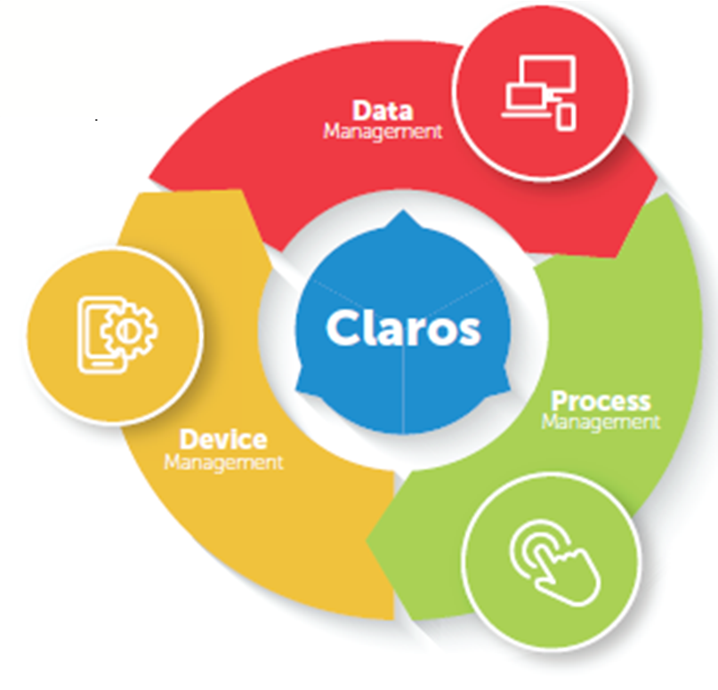
Continuing to create clarity
Notes:
We are continuing to invest here <walk through each category>

Slide 4
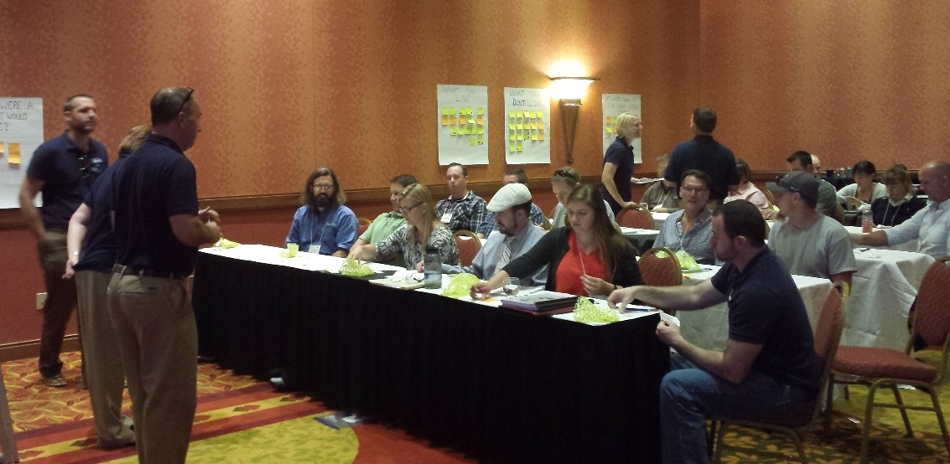
Thank You…
For helping us
For helping each other
Notes:
Thank you for helping us get better. Your voices this week were heard. <<Mention survey? As you may have guessed, we’ll be sending you a survey about the conference. We take your feedback VERY seriously and would appreciate you taking the time to let us know how we can do better for next year.>>
Thank you for helping each other get better. Special recognition to those who presented. . .if you didn’t present, consider it for next time or do so at a regional conference. . .the knowledge exchange amongst you the users is what makes these conferences so powerful. The people in this room coming from utilities or sites which ensure water quality – you do important work. As an outdoorsman who grew up on rivers, and as a parent of a growing daughter who is at school right now, thank you for your commitment to our world.

