Slide 1
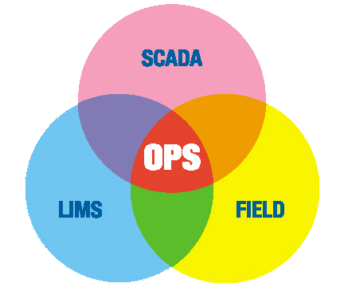
2008 Gray Matter Systems & GE Fanuc User Group and Developers’ Conference Municipal Reporting with OPS SQL Scott Dorner, OPS Systems

Slide 2
OPS SYSTEMS
We are a Commercial Off The Shelf Software developer and implementer for the Water & Wastewater Industry
Industry experts with 8 programmers, 3 chemists, licensed operator, PE… We have over 2000 water/wastewater customers and have been in business for 30 plus years.

Slide 3
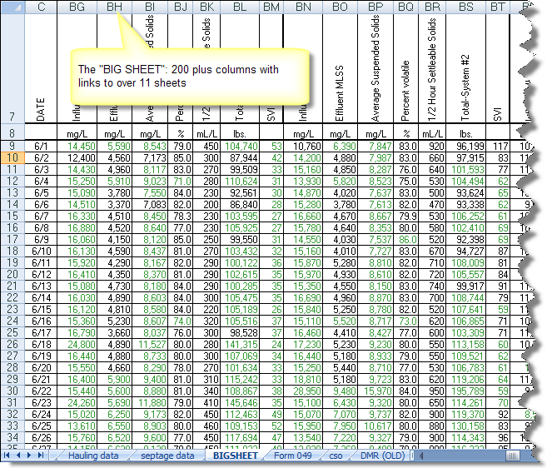
The clutter of data
In your home, the accumulation of “stuff” makes it difficult to find anything.
At the plant, the accumulation of data makes it difficult to find answers.

Slide 4
Why do we collect it
SCADA – Detailed Historical record of what happened
LAB/LIMS – Detailed record of how results were achieved, audits.
Operations – To verify plant is in control and operators are paying attention
Calculations – Cause we have to for regulatory reports

Slide 5
LIMS
Laboratory Information Management System
Used by commercial Labs and Medium to large plant labs
Most small plants use paper system and Excel

Slide 6
LIMS
Sample Scheduling
Sample Login and Tracking (Chain of Custody)
Enter/Verify Results
Report Results
Instrument Interfacing
QC Analysis

Slide 7
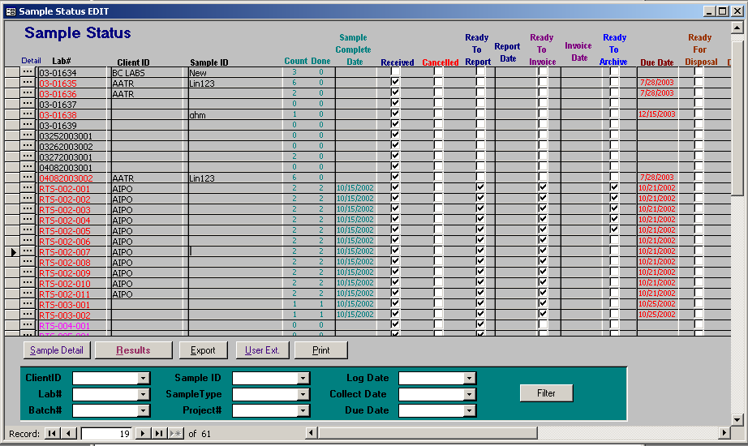
Review samples in your lab

Slide 8
LIMS
Aspen by Telecation
Labworks by Perkin Elmer
Lab Cal by OPS Systems
Tribal
LabVantage
Many more

Slide 9
Separate systems create the islands of Excel
SCADA – Produces reports via Excel
LAB – LIMS produces COA and COC reports that are printed, faxed, emailed.
Operations – Paper and Excel forms
Regulatory Reporting is a scramble. Usually one gatekeeper who roles it all together into Excel.

Slide 10
Spreadsheet nightmares
Easy to start and make progress quickly on a problem.
Over time it evolves into a cross linked monster with hidden columns, macros, etc…
Different Views: Each department has it’s “own” copy of the data. Same data entered many times instead of imported directly from the source
Not a database, no audit, multiuser capability

Slide 11
Spreadsheet nightmares
Where did this number come from?
Who changed my number?
Why is this number different in this report?
Am I liable for errors in regulatory reports?

Slide 12
Spreadsheet nightmares
Typically only one person knows how to keep it alive. Studies show this is typically a high paid analyst who spends up to 2.5 days/week managing the spreadsheet.
“Instead of analyzing data, these high-priced employees act like surrogate information systems professionals, gathering, massaging, and integrating data. “ - TDWI Best practices report: Strategies for managing spreadmarts by Wayne Eckerson and Richard Sherman
Hidden Cost: With average salary of the analyst at 65K and several spreadsheets in an organization cost quickly add up. - Best Practices for your information management provider, Barry Liner, AEM

Slide 13
Portland, ME
General belief that the data was in SCADA:
Review of monthly reports revealed:
13 to 20% Continuous process data (SCADA)
20 to 30% from the Lab (Manually entered)
20 to 30% Manual entry (process by operators)
25% Calculations (combination of the above)
<3% Other sources
Many of these sources were “unsecured”
“I want to spend time analyzing information, not formatting and collecting data.” – Scott Firmin, Portland Water District, creator of “Giant Sheet”

Slide 14
Existing System
7.28
7.28
7.82
7.82

Slide 15
OPS SQL – The power of information
Data Management Software for Water and Wastewater Systems
Combines SCADA, Lab, and operator log data and performs calculations on the data
Reports and charts turn the raw data into information
Integration with iFix 5.0 (and 4.5) as part of the Water Solutions Pack 2008.

Slide 16
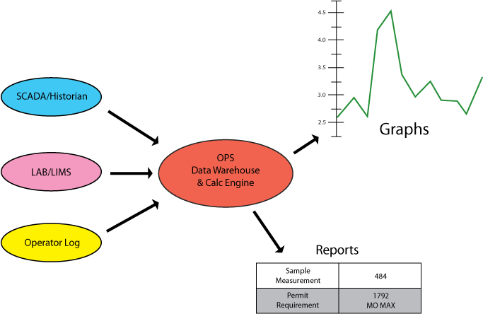
OPS SQL – The power of information
How does it work
Data is automatically transferred from SCADA/Historian and LIMS systems
Data can also be entered through OPS data entry forms, PDAs, or Tablet PCs.
From the central location you can run calculations and analysis. Allowing you to easily produce…
Accurate regulatory reports
Graphs / Analysis

Slide 17
OPS SQL – The power of information
Saves Time
Data is automatically transferred from SCADA/Historian and LIMS systems
Easy to Use
Designed for operators.
Data entry forms can be designed to look just like your paper forms.
Templates for regulatory reports such as SWTR, NPDES, DMRs…
Your people can design reports, forms and graphs
Data at your fingertips
Reports and Analysis is readily available to the people who need it
Accurate regulatory reports including eDMRs, SWTR Reports, NPDES, OH4500.
No more unsecured spread sheets, islands of data, duplicate entries

Slide 18
OPS SQL – The power of information
Powerful
Over 100 Industry specific calculations including Loadings, Dosages, CT Ratio, Percentiles, Geometric Means, SWTR compliance
Properly handles data qualifiers (<,>, TNTC) in calculations such as weekly averages, loadings, etc… according to your rules
Track your permit and QC limits
Schedule printing/emailing of reports and graphs

Slide 19
OPS SQL – The power of information
Peace of mind
Data is stored in standard databases such as Microsoft SQL Server, Oracle or MSDE.
All data is audited. You will know who and when data was entered, edited, deleted.
Data Approval can be used to further secure the data. Once privileged users approve the data only they can edit it.

Slide 20
Operations 1800 WTP & WWTP
LIMS 150 WTP, WWTP & enviro. Labs
Maintenance 800 WTP & WWTP
Notes:
Note: Edit this slide with your own information,but be sure to leave the link to www.opssys.com.

Slide 21
DEMO
Notes:
Note: Edit this slide with your own information,but be sure to leave the link to www.opssys.com.

Slide 22
Questions?
Scott Dorner, Product Manager
OPS Systems
spd@opssys.com
www.opssys.com
800-677-0067
http://www.opssys.com/instantkb/article.aspx?id=11483

