Slide 1
Breakout 1 – River Birch ABC Wednesday 1:00PM – 2:15PM KPI Reporting & Calculations Scott Dorner – Claros Product Manager, Hach

Slide 2
What is a kpi?
Key Performance Indicator (KPI) AKA:
Metric
Critical Success factor
Performance Measure
A way to measure progress towards our goals. The simple fact of tracking our KPIs increases awareness within the organization the importance of the goals.
Goals:
Ensure compliance while reducing costs (Energy, Chemical, etc…)

Slide 3
Good vs bad kpis
Good
Specific
Measurable
Actionable/Achievable
Bad
Hard to measure/quantify (based on feeling, i.e. customer satisfaction)
Encourages wasteful actions (Effluent TSS of zero, CFE Turb of .0001)

Slide 4
Common KPIs
Efficiency Goals:
Chemical Cost per Day
Chemical cost per MG
% unaccounted – Water Produced vs Water Billed
BOD Removed vs KWH uses
KWH per MG
Process:
SRT, F/M, Targeted Waste
Settled Water Turb
Regulatory
Effluent Quality
Filter Turbs, CT, POE Quality

Slide 5
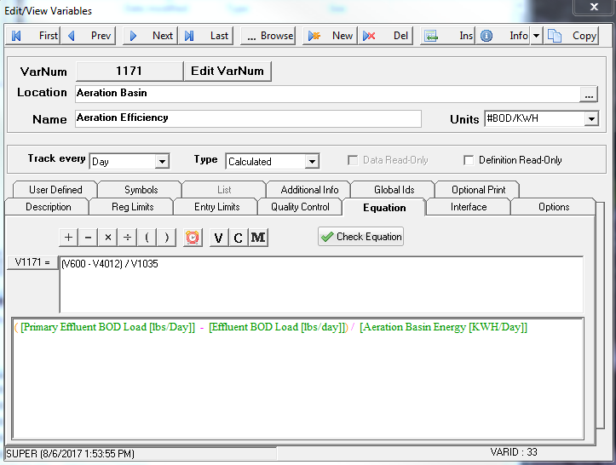
Create KPI calculations in WIMS
Create the Calcs:

Slide 6
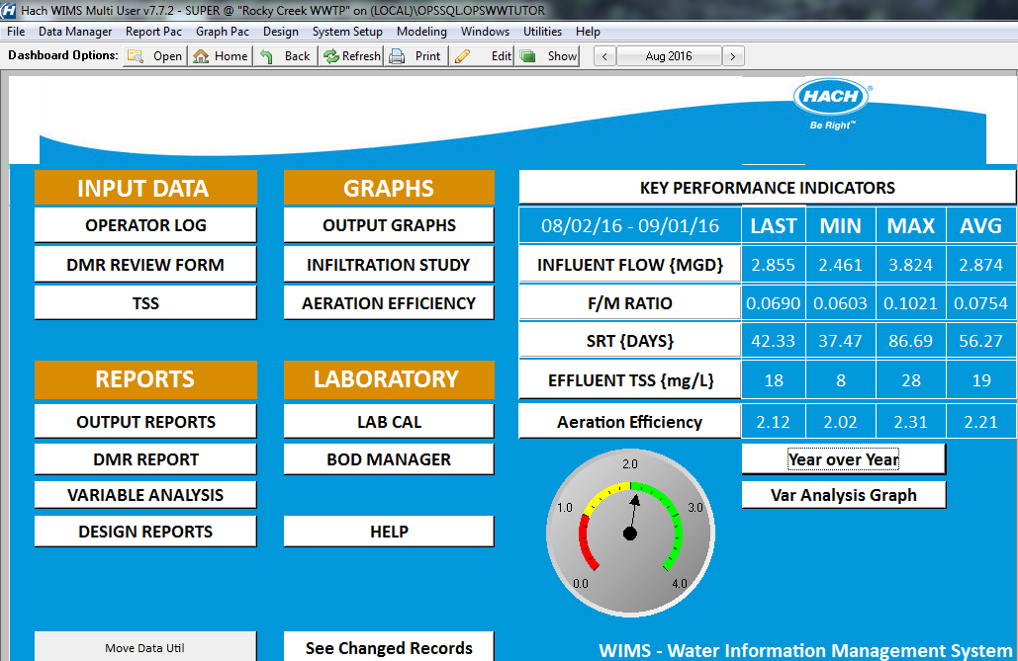
Visualize
Add to Dashboard – Gauge, Value, Trend Graph, Year Over Year

Slide 7
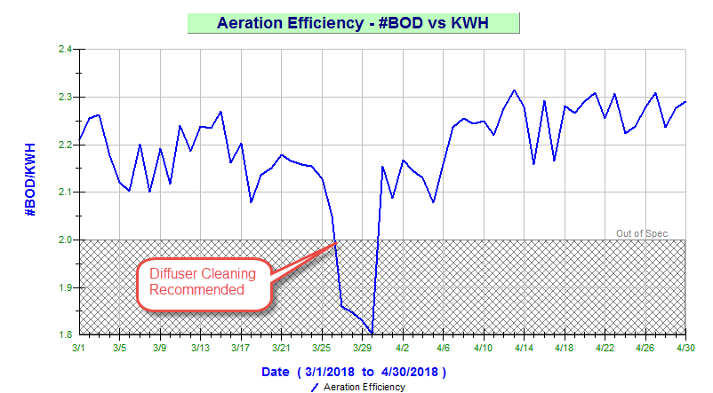
Analyze
Long term trend graph shows KPI falling out of range. Diffusers need to be cleaned to maintain Efficiencies.

Slide 8
Analyze KPI with statistical process control
The goal of SPC is to identify when we need to look deeper into a situation or is this just “noise”.
With properly set control limits, we can identify when the process has shifted or become unstable. With this knowledge, we can then study that particular situation (known as a “special cause”), identify root cause, and come up with a plan to minimize or eliminate these occurrences.
Walter Shewhart (founder of statistical quality control) found that control limits placed at three standard deviations from the mean in either direction provide an economical tradeoff between the risk of reacting to a false signal and the risk of not reacting to a true signal – regardless the shape of the underlying process distribution.

Slide 9
Interpreting SPC Control Charts
All points above or below the Upper and Lower Control Limit
2 Consecutive points are above or below the Warning Limits
7 Consecutive points are on one side of the mean
5 Consecutive points are sloping in one direction
The following rules are derived from the “Western Electric Rules” - “The Western Electric Rules were codified by a specially-appointed committee of the manufacturing division of the Western Electric Company and appeared in the first edition of its Statistical Quality Control Handbook in 1956.[2] Their purpose was to ensure that line workers and engineers interpret control charts in a uniform way” - Wikipedia

Slide 10
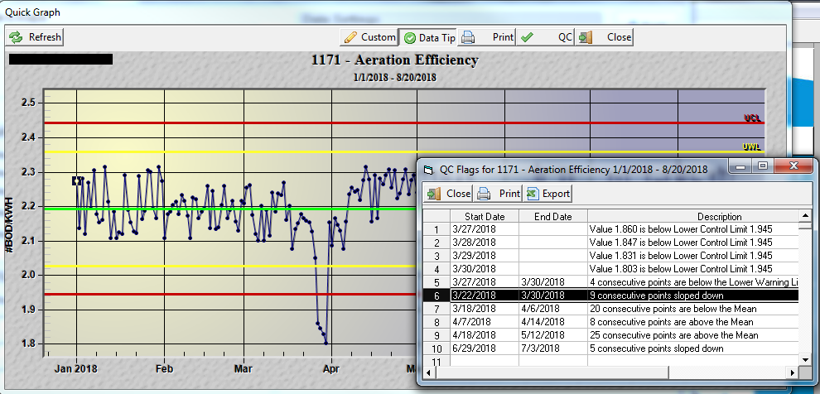
Interpreting SPC Control Charts

Slide 11
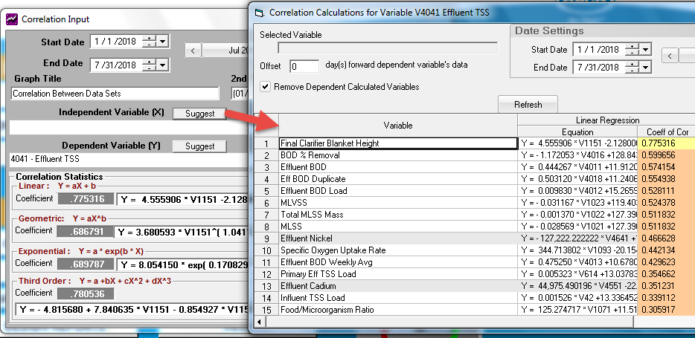
Correlations and Heat Maps

Slide 12
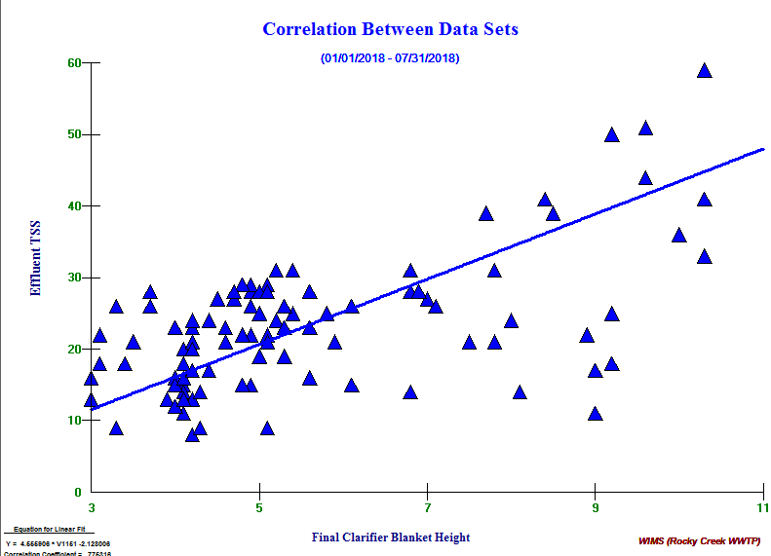
Correlation (causation?)

Slide 13
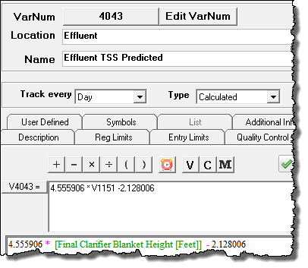
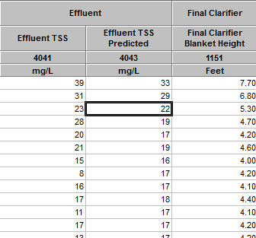
Predict (Model)
Y = 4.555906 * V1151 -2.128006

Slide 14
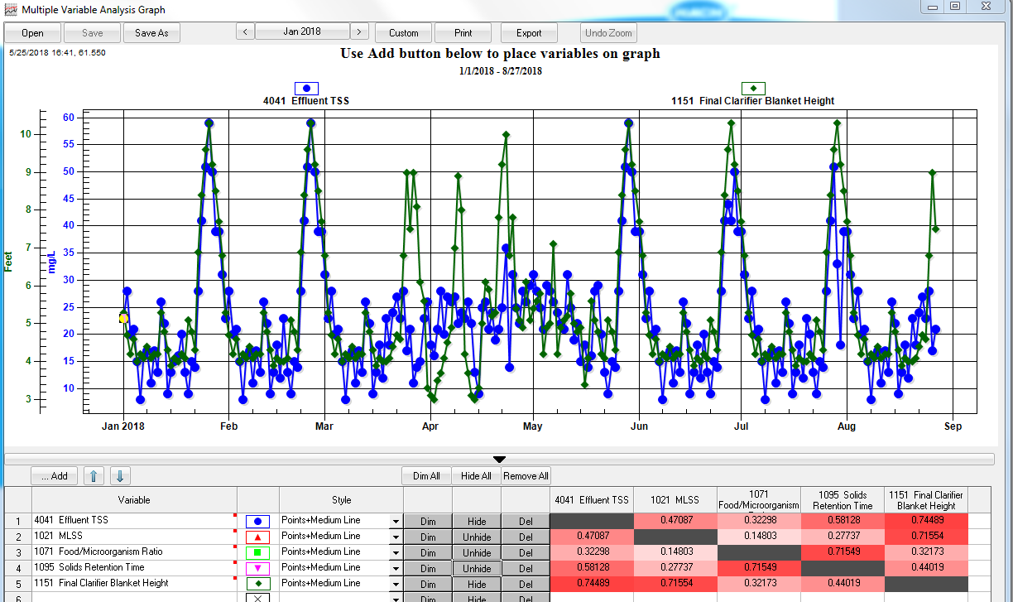
Heat map

