Slide 1
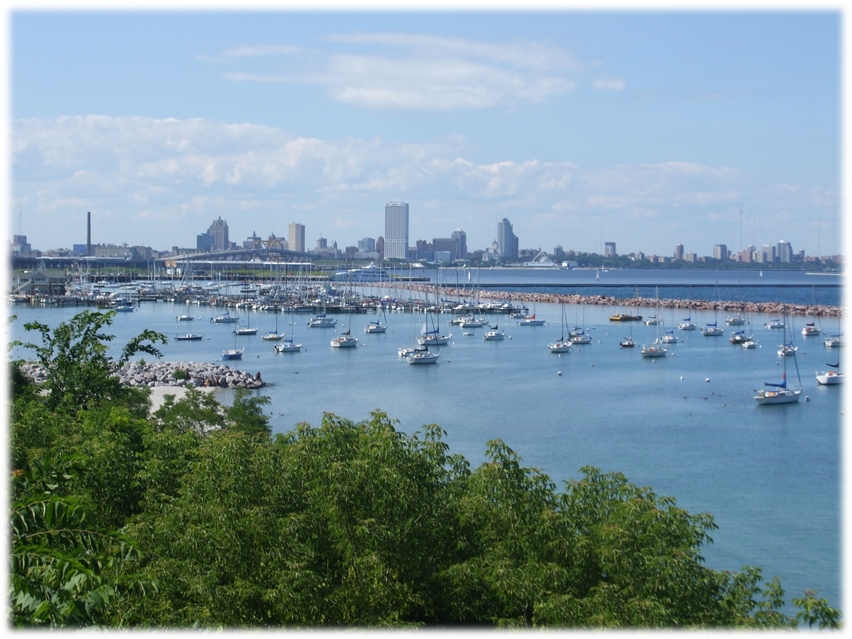
How WIMS is Used for Monitoring Renewable Energy and Energy KPIs at MMSD
Tanya Gregg, P.G.
Systems Monitoring Data Analyst
Milwaukee Metropolitan Sewerage District Special thanks to Sid Arora (MMSD)
Milwaukee Metropolitan Sewerage District

Slide 2
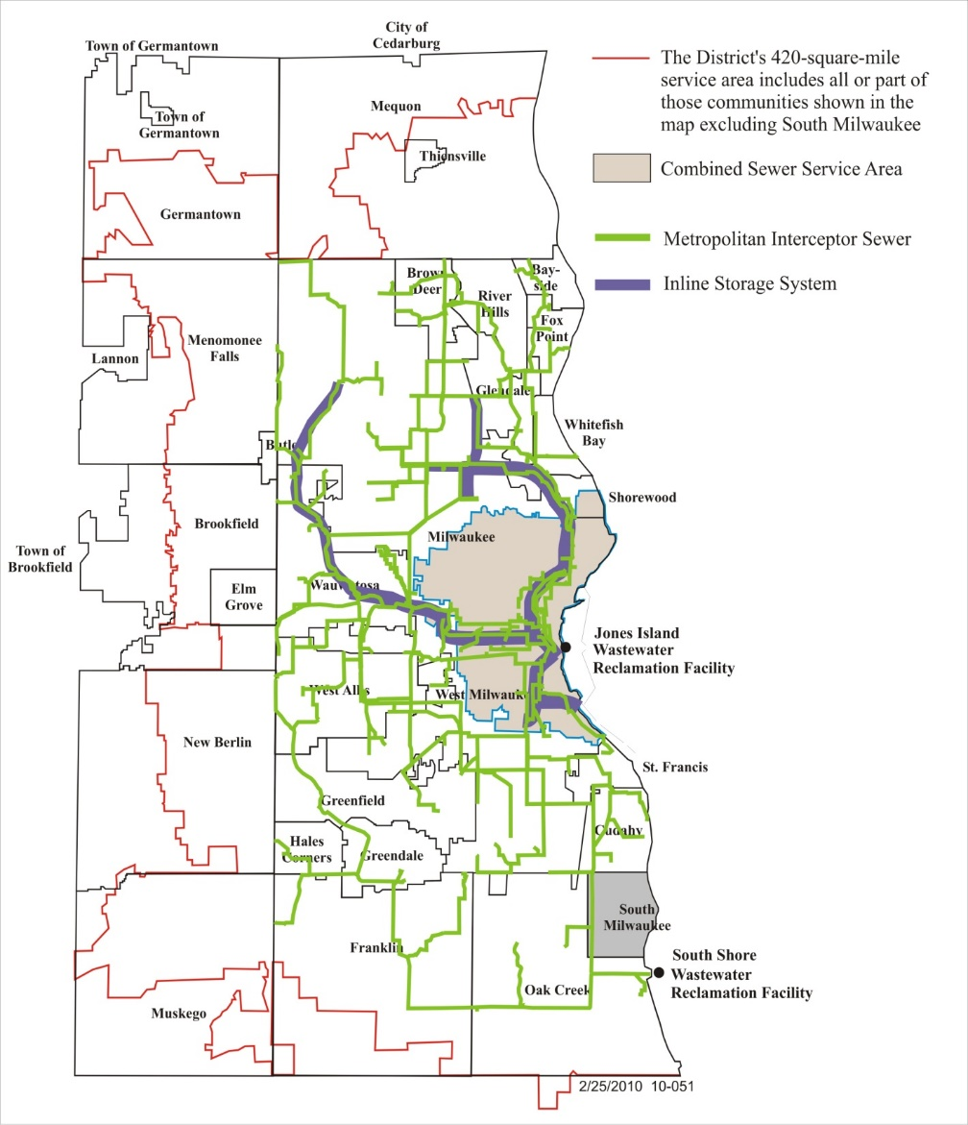
MMSD Serves:
1.1 Million Customers
28 Municipalities
411 Square Miles
Milwaukee Metropolitan Sewerage District

Slide 3
MMSD
- Water Reclamation Facilities (WRFs)
Jones Island (JI) - 1925
South Shore (SS) - 1965
(Managed by Veolia)
- Two Inline Storage Systems
432 MG
89 MG
- 300 miles of Interceptors
from 6 to 150 inches
Milwaukee Metropolitan Sewerage District

Slide 4
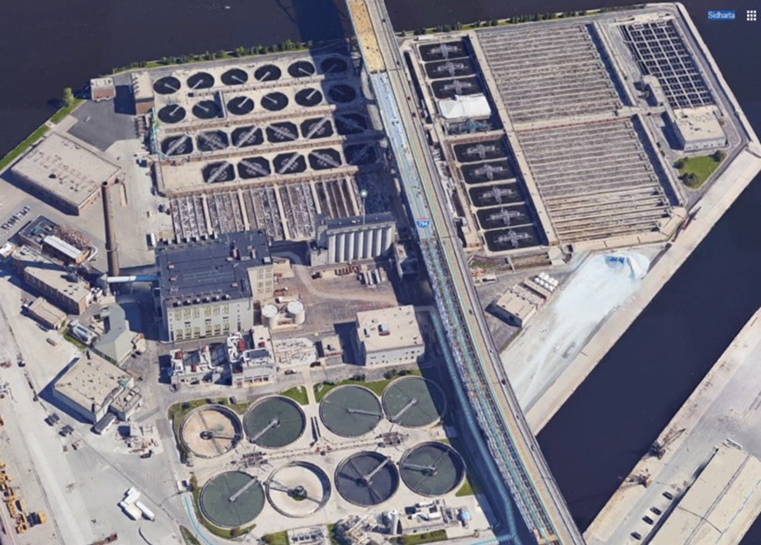
Water Reclamation Facility Jones Island
Peak flows: 330 MGD
Dry weather flows: 60-70 MGD
Mostly combined sewer area
Conventional activated sludge
Sludge drying and dewatering
Milorganite production
Milwaukee Metropolitan Sewerage District

Slide 5
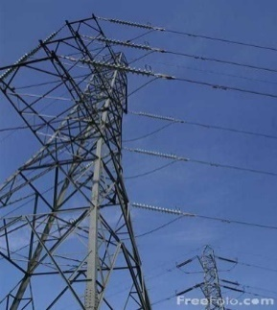
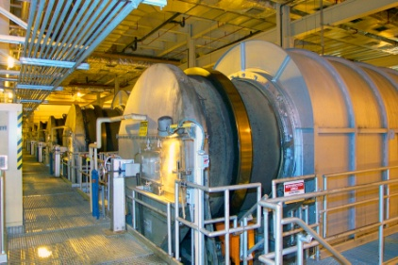
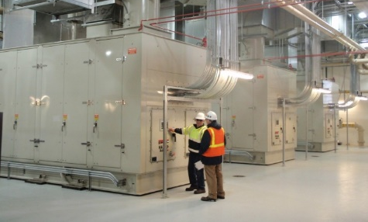
MMSD Energy
Combined Heat and Power System
Plant Electric Load 11.0 MW
Natural Gas to supplement LFG turbine waste heat
Waste
heat
Dryers
Electricity
Solar Turbine Generators 4.5 MW each – LFG/NG
Natural Gas (building heat)
Landfill Gas
Electricity for Plant Needs
Natural Gas
Jones Island WRF
GE Turbine Generator
15 MW – NG
Courtesy of Sid Arora, MMSD
Milwaukee Metropolitan Sewerage District
Notes:
JI Combined Heat and Power: turbines convert natural gas to electricity for plant use
Utilize waste heat for drying biosolids
Create Milorganite
Commercial fertilizer

Slide 6
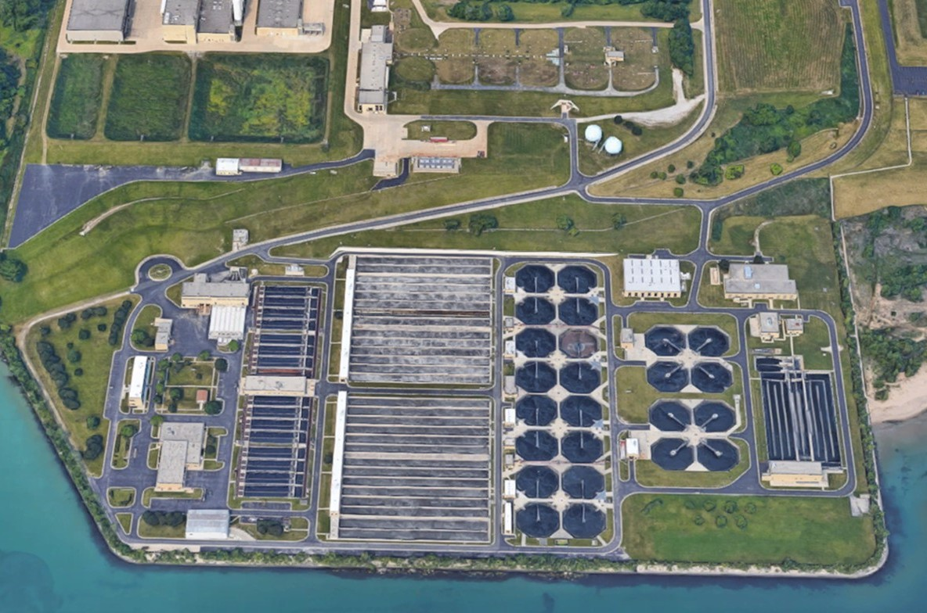
Water Reclamation Facility South Shore
Peak flows: 300 MGD
Dry weather flows: 60-70 MGD
Separate sewer area
Conventional activated sludge, chemical P removal
12 digesters
CHP using digester gas
Milwaukee Metropolitan Sewerage District
Notes:
Digester gas engines at South Shore
Engine generators at SS produce electricity
Utilize waste heat
Biosolids also pumped from JI
Still must purchase significant $ of electricity

Slide 7
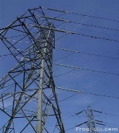
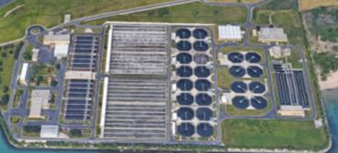
South Shore Digester Gas Production and Utilization
Gas Storage
Spheres
Electricity
Plant Electric Load 5.0 MW
Gas Compressors
Digester Gas/Natural Gas
Flares
Digester Gas
4 CAT Engine Generators- 0.9 MW each
Boilers
Anaerobic Digesters
15 MG
98ºF
White Superior Engine Generator- 1.5 MW
Feed Sludge
-Primary Sludge
-Airport Deicing Fluid
-High Strength Waste
-TWAS
Heat Recovery System
Digested Sludge
Sent to Jones Island
for Milorganite Production
Courtesy of Sid Arora, MMSD
Milwaukee Metropolitan Sewerage District
Notes:
Electricity to drive plant operations:
Aeration: 35%
Drying and dewatering facility: 21%
Deep tunnel pumping: 10%
Raw WW pumping, prelim, primaries: 10%
Natural gas driven turbines to generate plant electricity
Natural gas for biosolids dryers (when turbines are off) and heating
Waste heat from turbines to dry biosolids
Waste heat from engine generators for building heat and heating digesters

Slide 8
MMSD Renewable Energy KPIs
2035 Strategic Vision (Adopted Dec. 2010):
Meet a net 100% of energy needs with renewable energy sources
Historical Data - good data to compare
Metering resources of energy data
Performance trends and reporting
Meet 80% of energy needs with internal, renewable sources
Sub metering to determine where needs
Alternate fuel sources
Reduce carbon footprint by 90% from its 2005 baseline
Emissions data capture
Project / scenario forecasting
Milwaukee Metropolitan Sewerage District
Notes:
Historical data – ensure that all values are coming into Hach. Are

Slide 9
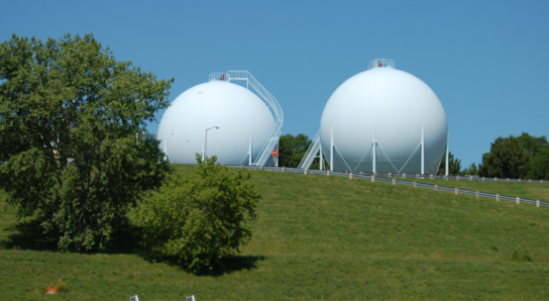
Hach WIMS and MMSD Energy Monitoring
Energy Data and Hach Process:
2013 – Decision to use Hach as data management for energy data
2014 – Closer look into Energy monitoring in Hach
New Variables, graphs, report
Air Permit Monitoring Report
2015 - 2016 – Energy Dashboards
New variables, unit conversions
Energy Reports, graphs, KPIs
Main dashboards for MMSD users
2016 - 2018
Advanced Report Development
New Power Meters (sub-metering)
WE Energies Import
Future Forecasting - > SCOPE 5
Milwaukee Metropolitan Sewerage District

Slide 10
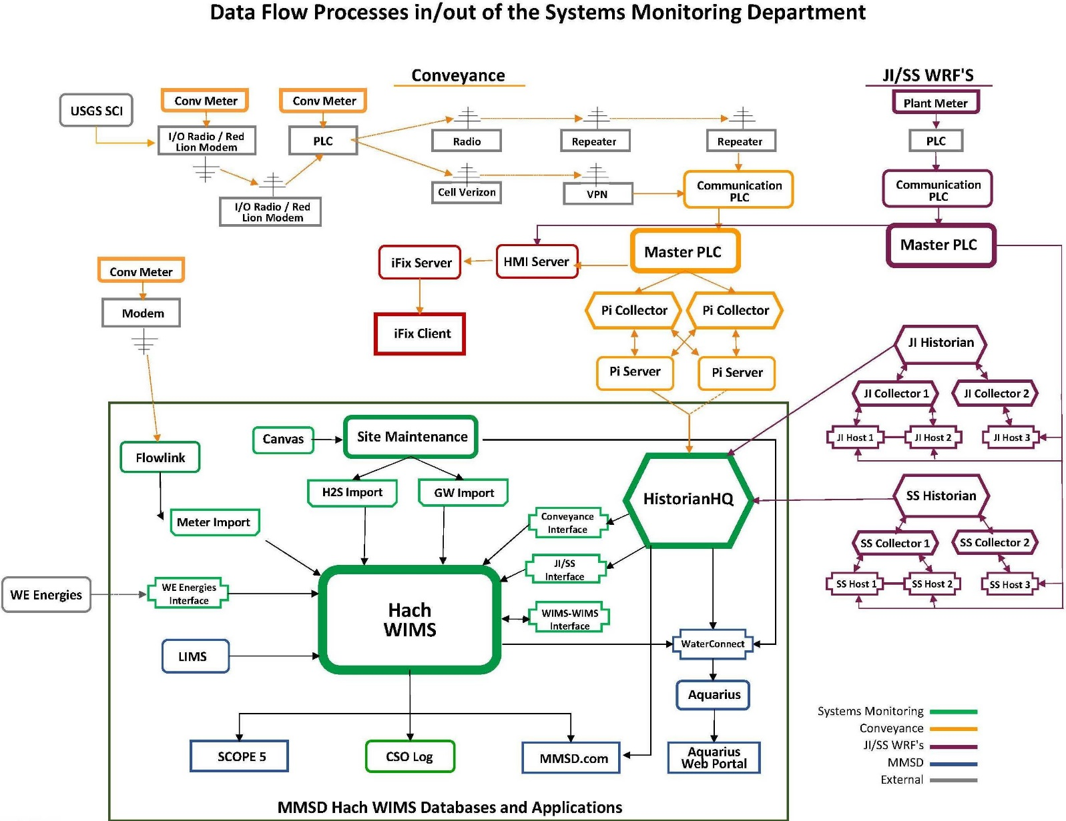
Hach WIMS and MMSD
Hach WIMS:
4 Facilities
(GW, Conv, JI, SS)
Shared by Veolia
~12,800 variables
Milwaukee Metropolitan Sewerage District

Slide 11
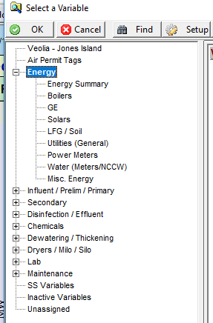
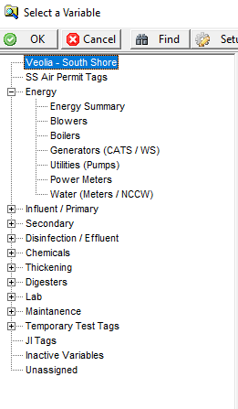
Hach WIMs Energy Monitoring
Energy Variables
Hach Energy Data:
Location Groups
Energy Variables
JI ~490
SS ~260
Data Flow Processes:
Historian Collector – SCADA DATA
LIMS
Operator Entry
Milwaukee Metropolitan Sewerage District
Notes:
First Steps: Build new variables to compare historical data to and conduct QA/QC.

Slide 12
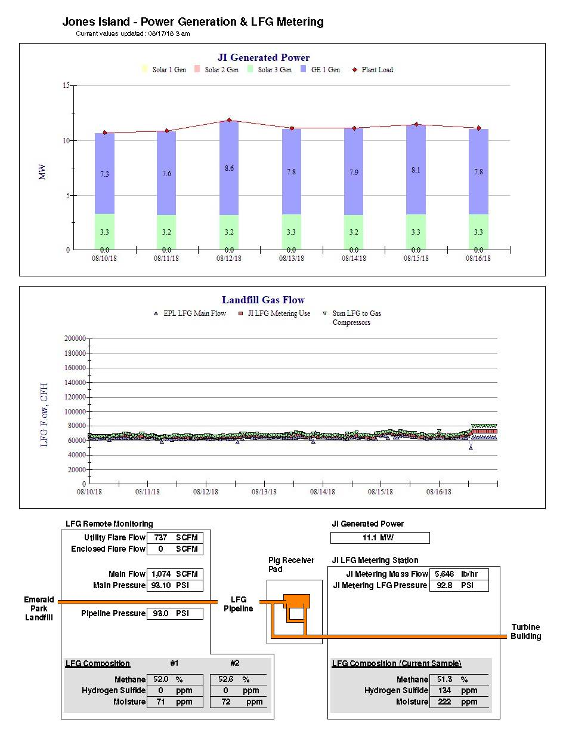
JI Water Reclamation Facility Energy Reporting
Energy Monitoring Reports:
Air Permit Monitoring Report
QA/QC data
Quick indication of outliers
LFG Monitoring
Performance Monitoring
Pipeline Issues
Power Generation/Usage
Track electricity generation and plant loads
Quick analysis of issues
Fuel Usage
NG vs LFG vs WH
Dryer – WH monitoring
Dryers in Service
WH Usage
Soil moisture trigger reports
Soil moisture related to LFG
Milwaukee Metropolitan Sewerage District

Slide 13
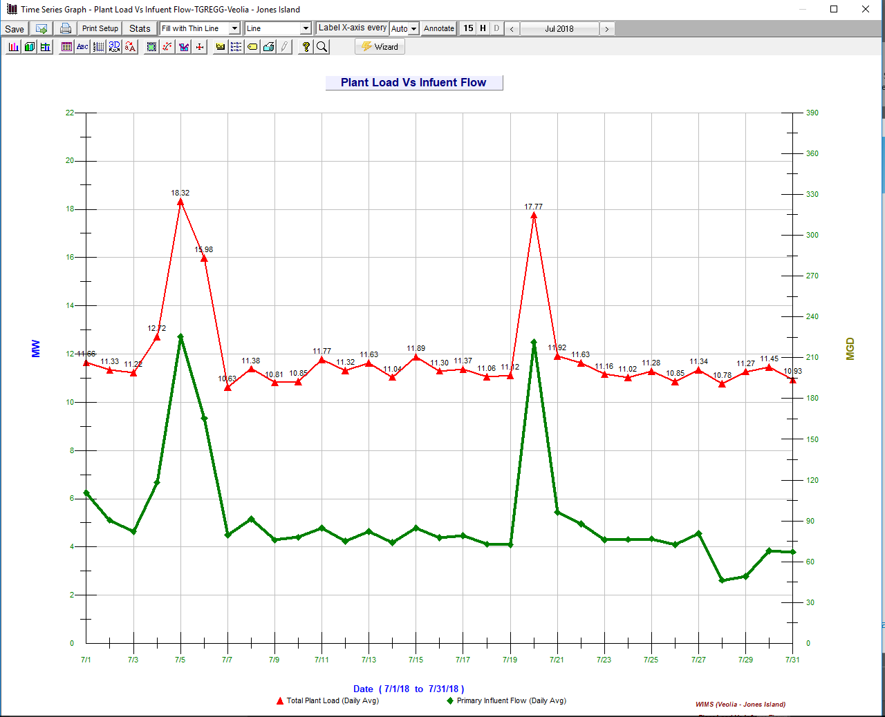
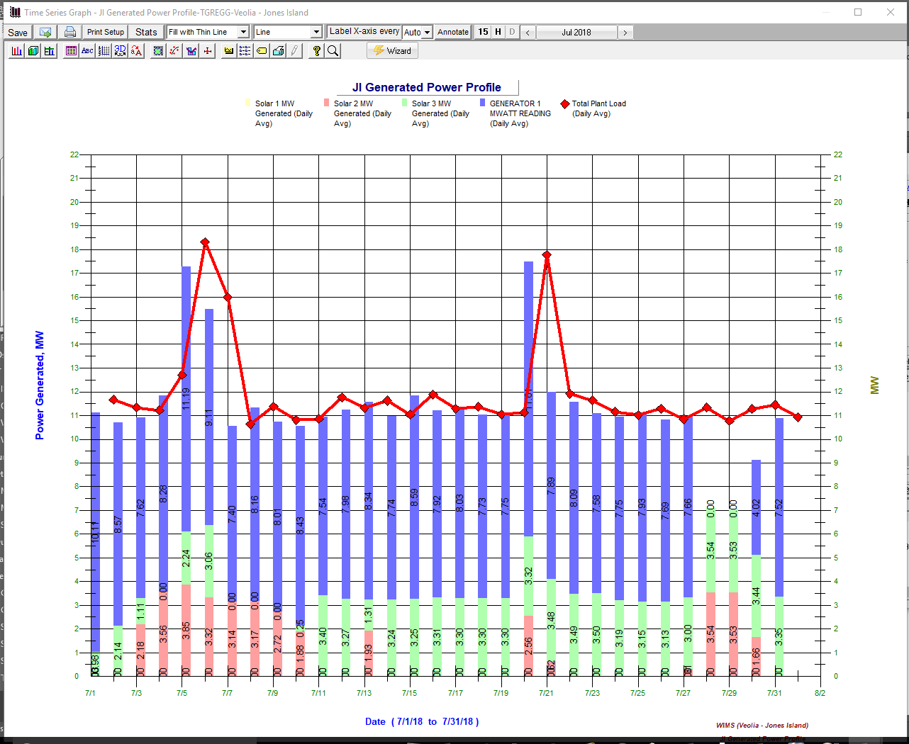
JI Water Reclamation Facility Energy Trends
Milwaukee Metropolitan Sewerage District

Slide 14
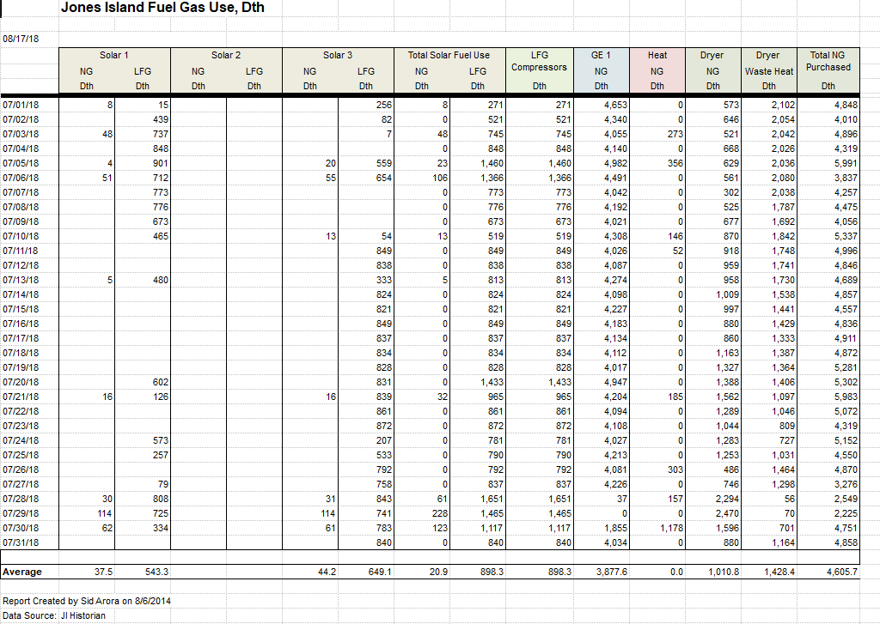
JI Water Reclamation Facility Energy Reporting
Milwaukee Metropolitan Sewerage District

Slide 15
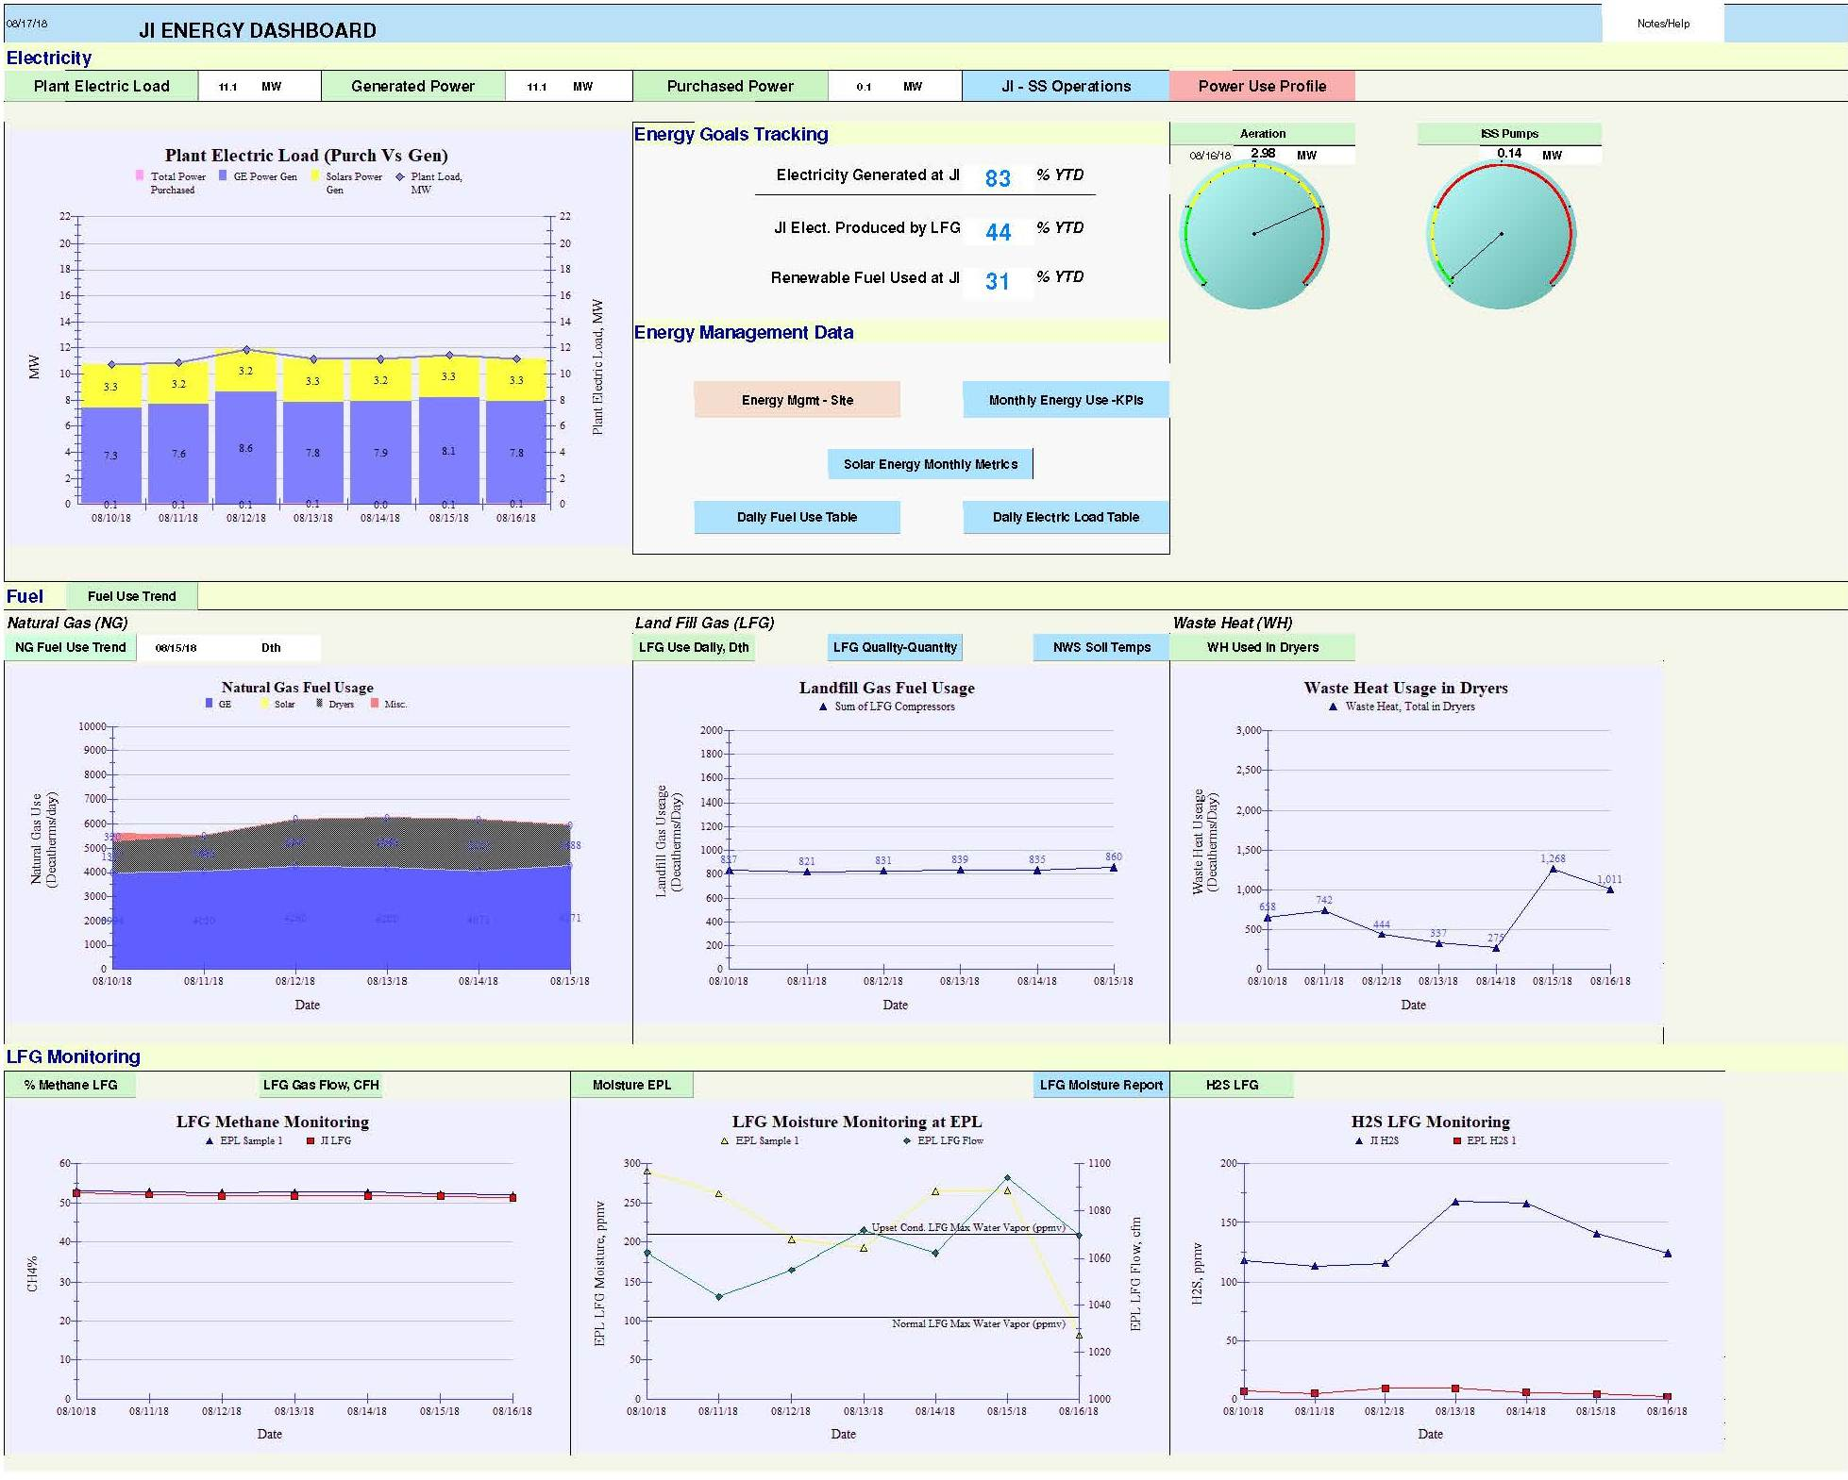
JI Energy Dashboard
Milwaukee Metropolitan Sewerage District
Notes:
Started in 2015 with a whiteboard and an idea. Developed new variables to get consistent units, new graphs, and reporting tools.

Slide 16
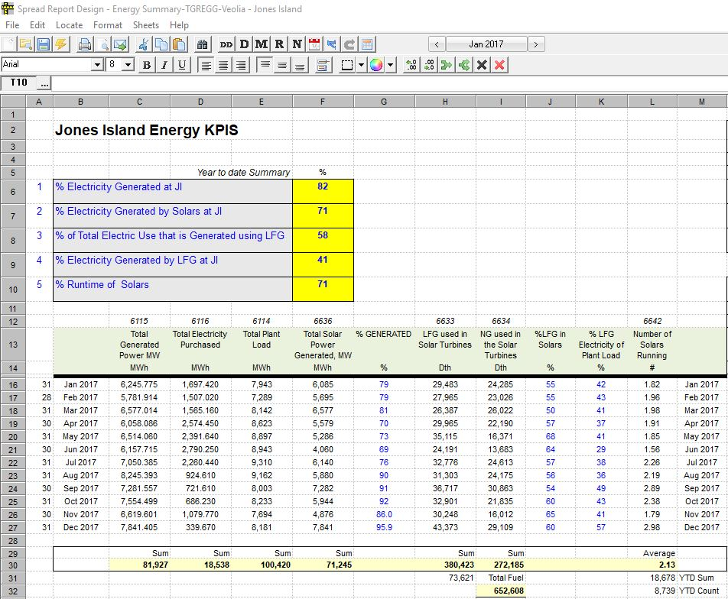
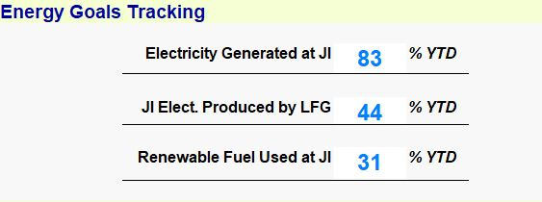
Water Reclamation Facility Energy KPIs at Jones Island
Milwaukee Metropolitan Sewerage District

Slide 17
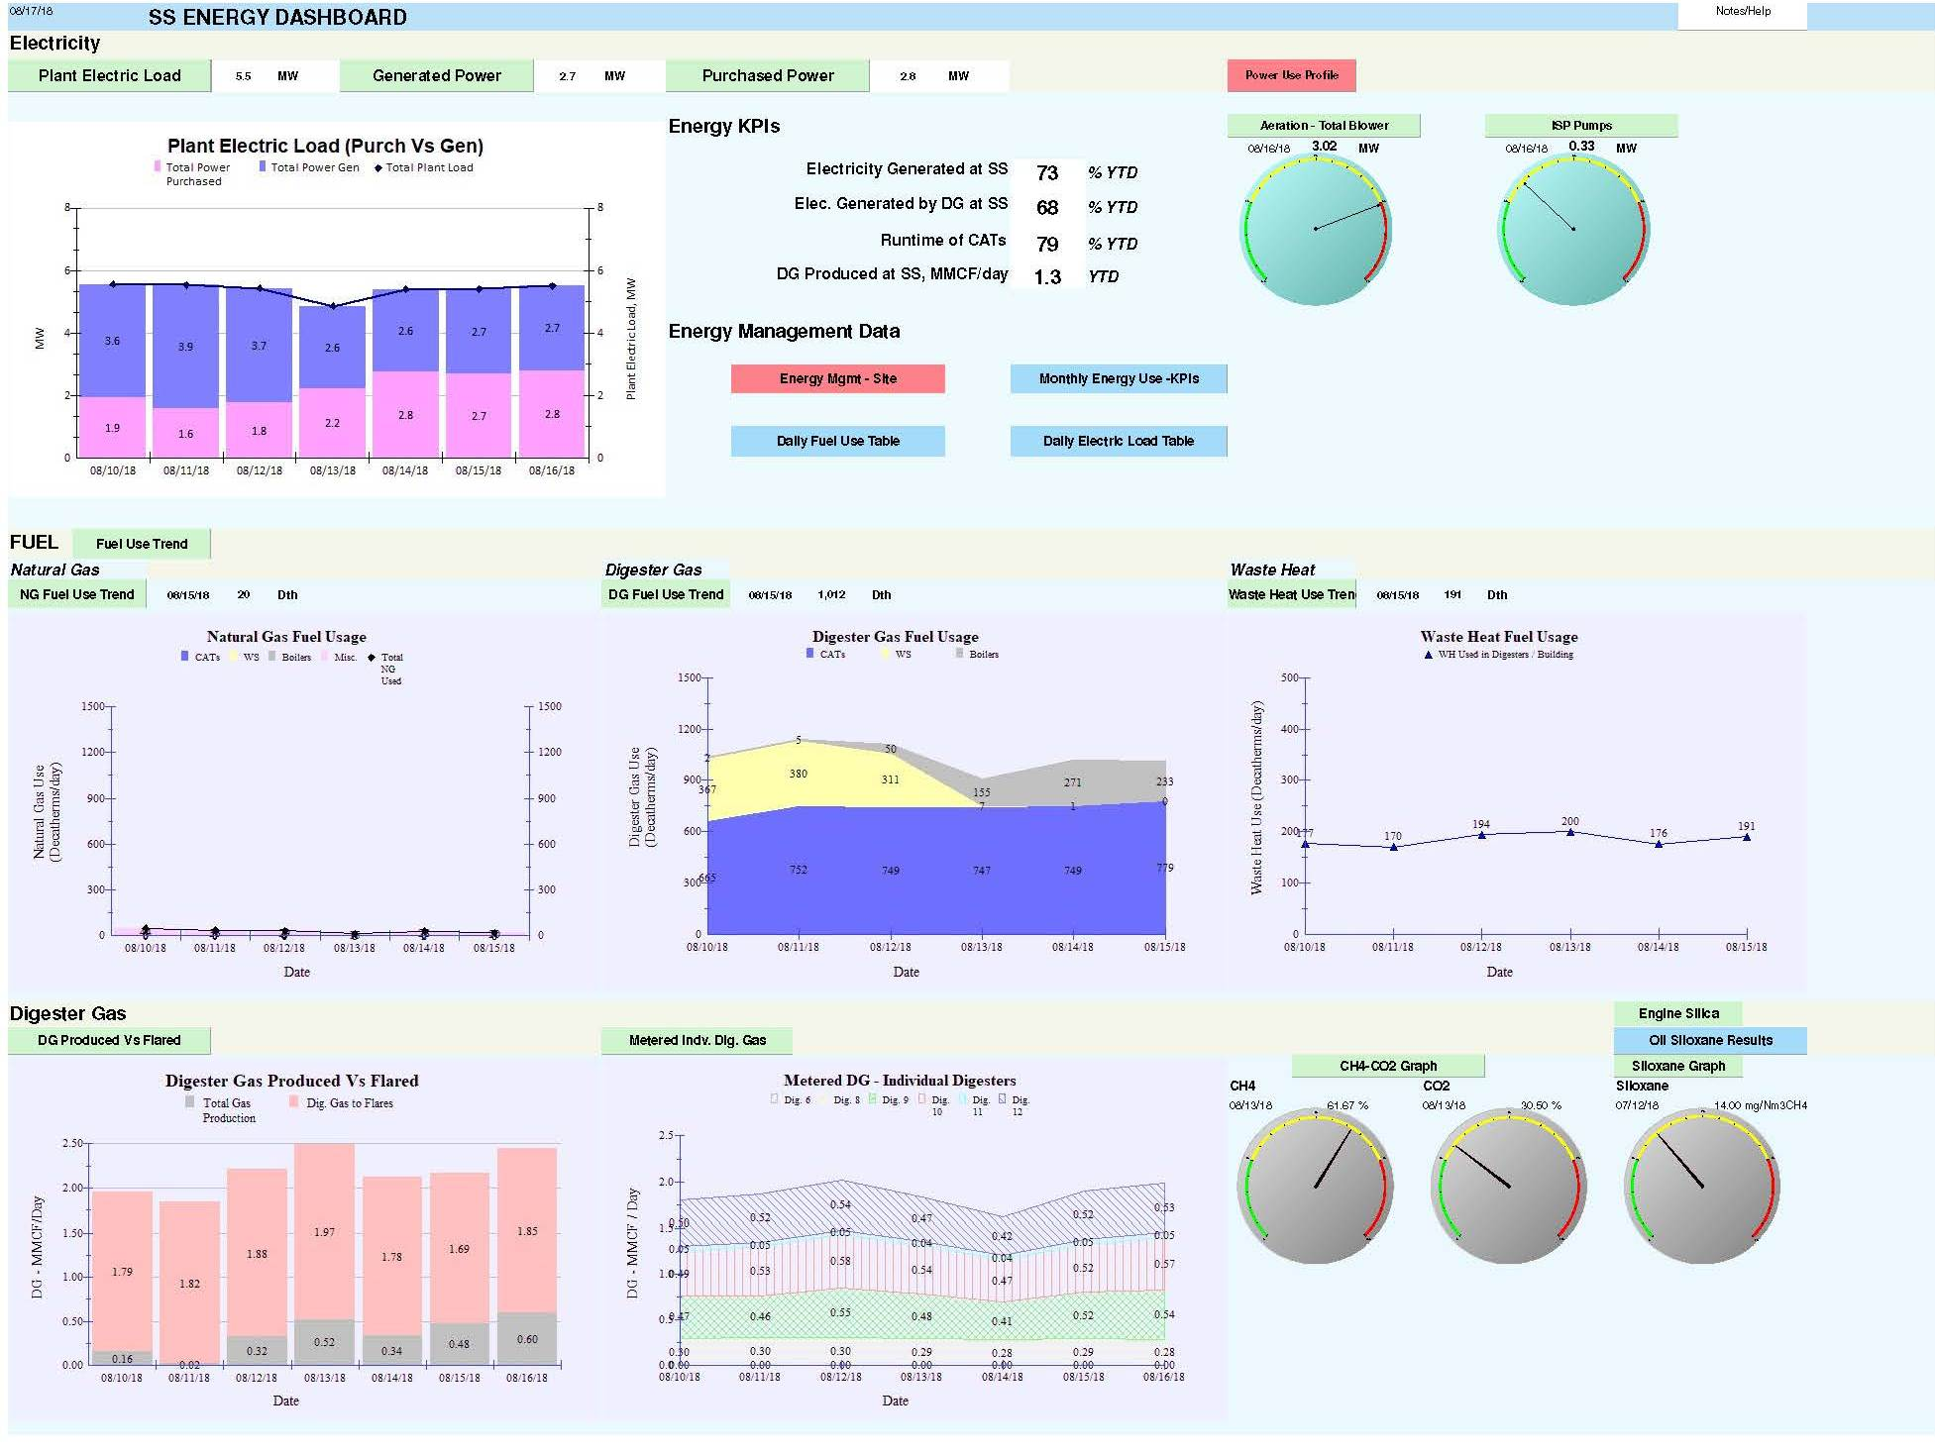

Slide 18
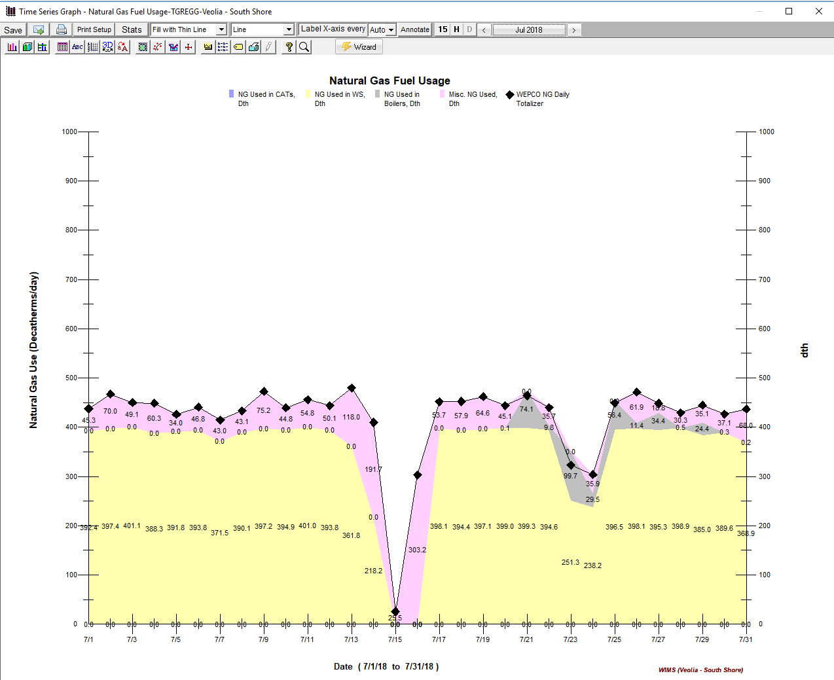
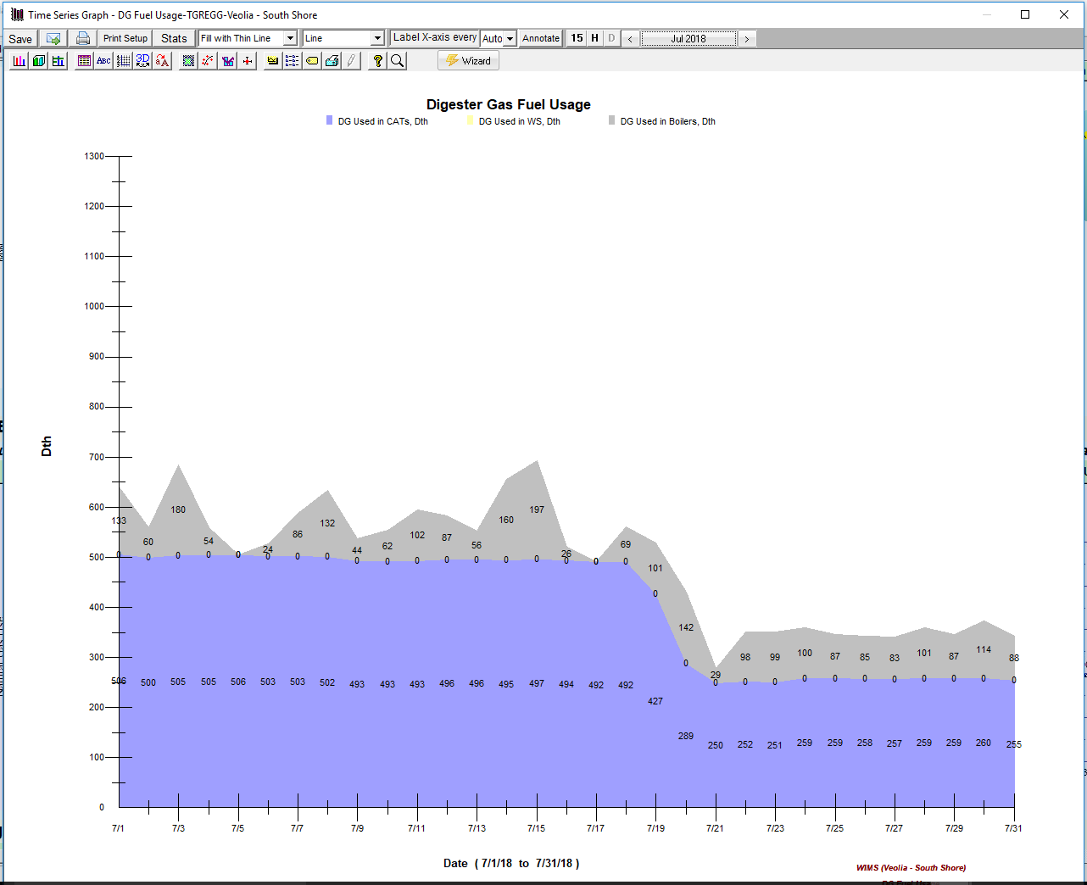
South Shore WRF Fuel & Electricity
Milwaukee Metropolitan Sewerage District

Slide 19
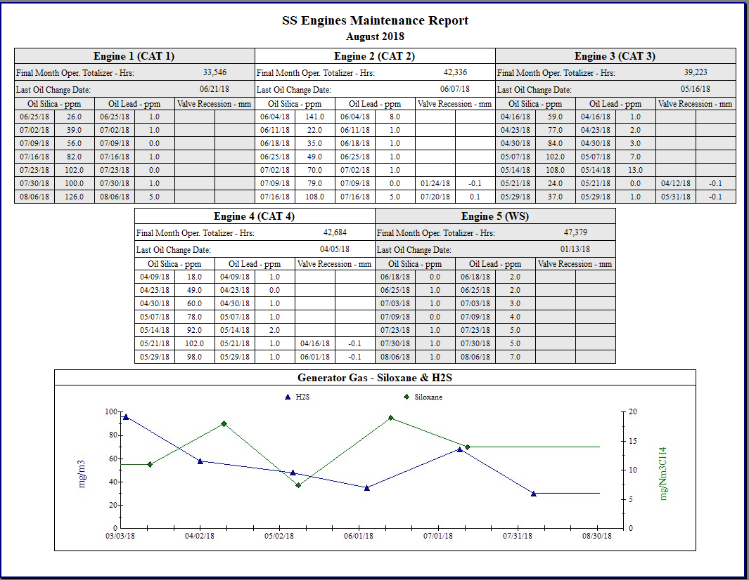
South Shore WRF Engines Maintenance
Milwaukee Metropolitan Sewerage District

Slide 20
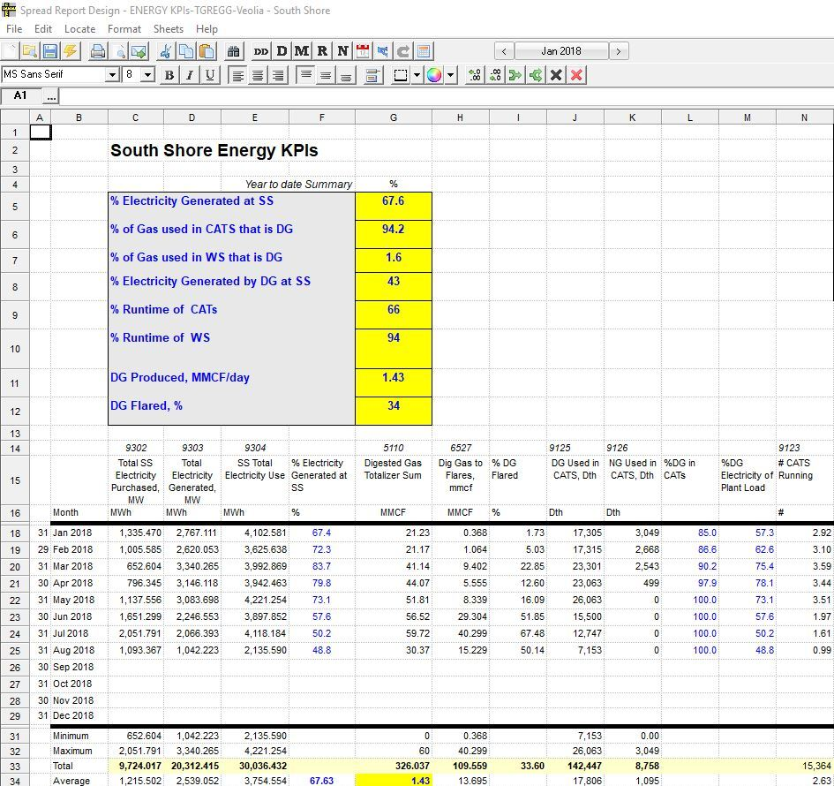
Water Reclamation Facility Energy KPIs at South Shore
Milwaukee Metropolitan Sewerage District

Slide 21
Hach WIMS and MMSD Energy Monitoring Next Steps
Energy Data and Hach Process:
2018 & Beyond
Future Forecasting - > SCOPE 5 & other applications
Individual process unit KPI development
Identify projects/processes for cost and energy savings
Identify Energy reduction considerations
Hach WIMS:
2018 & Beyond
WE Energies Import
Vehicle fuel consumption import
Hach Trends / Reporting for long-term
KPI Report development
Milwaukee Metropolitan Sewerage District

Slide 22
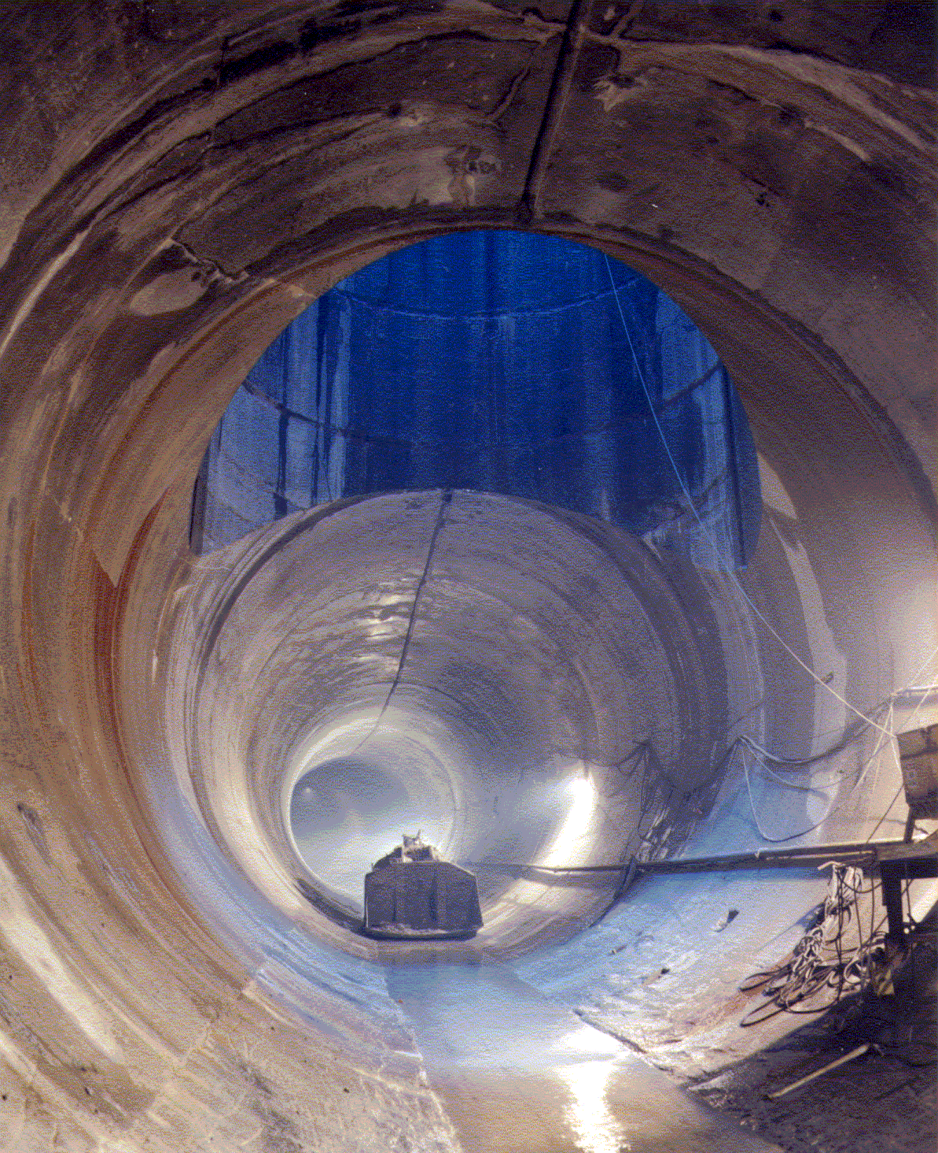
Thank you! Questions???
Milwaukee Metropolitan Sewerage District

