Slide 1
Process management software
Bob Dabkowski, CWP
Application Development Manager
bdabkows@hach.com
800.227.4224 x2191

Slide 2

Lots of confusion in the industry
What to measure?
Where to measure it?
How to turn data into information?
Wrong sensor/Wrong location:
  Bad data
  Distrust
  Doesn’t improve process
Notes:
There's a lot of confusion in the industry today about what to measure and where to measure it; how to handle all the data and ultimately how to turn that data into information for good decision making. The last thing you want to do is waste money on the wrong sensor in the incorrect location that no one trusts and doesn't improve your process.

Slide 3
ISE Probe
Mixed liquor ammonia measurement
analyzer
Ion Selective Electrode (NH₄⁺)
Design range: 1-1000 mg/L NH₄-N
Manual calibration vs Lab
  Weekly for first month
  Monthly thereafter
Manual cleaning 1/mo
Replace cartridge: 6-12 mo
pH must be < 8
No filtration required
Interferences:
  Quaternary Ammonium Compounds
  Surfactants
  Solvents
  …
Gas Sensing Electrode (NH₃)
Design range: 0.05-1000 mg/L NH₄-N
Automatic calibration
Manual cleaning 1/mo
Replace reagents/GSE membrane: 3 mo
pH independent
Sample filtration required
Interference:
  Ferrous Chloride
Ambient Temp: -4°F to 104°F
Notes:
For example, what are some differences between Ammonia Probes and Ammonia Analyzers?

Slide 4
ISE Probe
Mixed liquor ammonia measurement
analyzer
Good:
> 1 mg/L NH4-N
Municipal wastewaters
Commit to maintenance
Bad:
< 1 mg/L NH4-N
pH > 8
Industrial wastewaters
Good:
> 0.05 mg/L NH4-N
All wastewaters
Commit to maintenance
Bad:
Where ferrous is used
Ambient Temp < -4°F
Ion Selective Electrode (NH₄⁺)
Design range: 1-1000 mg/L NH4-N
Manual calibration vs Lab
  Weekly for first month
  Monthly thereafter
Manual cleaning 1/mo
Replace cartridge: 6-12 mo
pH must be < 8
No filtration required
Interferences:
  Quaternary Ammonium Compounds
  Surfactants
  Solvents
  …
Gas Sensing Electrode (NH₃)
Design range: 0.05-1000 mg/L NH4-N
Automatic calibration
Manual cleaning 1/mo
Replace reagents/GSE membrane: 3 mo
pH independent
Sample filtration required
Interferences:
  Ferrous Chloride

Slide 5
Ammonia based aeration control
Model based or feedback?
Control or modelling/trending?
How much DO is required to remove the ammonia?
Control the blowers directly, or have a separate DO control loop?
What if something else is limiting nitrification?
How to integrate sensor diagnostics into the controls?
Who will train everyone on the system?
How long will it take to write and test the logic?
What if a sensor fails?
How to store the data?
Who will write the O&M Manual?
Who will fix it if it breaks?

Slide 6
Ammonia based aeration control
Hach ABAC Module
What to measure & where ✓ Done
Can both model and/or control ✓ Done
Definition of control algorithms ✓ Done
4. Programming of control algorithms ✓ Done
5. Implementation on hardware ✓ Done
6. Testing of software and hardware ✓ Done
7. User interface ✓ Done
8. User manual ✓ Done
9. Backup stages ✓ Done
10. Communications interface ✓ Done
11. Data stored on IPC ✓ Done
12. Onsite & remote support ✓ Done
13. Setting of the plant-specific parameters During commissioning
Model based or feedback?
How much DO is required to remove the ammonia?
Control the blowers directly, or have a separate DO control loop?
What if something else is limiting nitrification?
How to integrate sensor diagnostics into the controls?
Who will train everyone on the system?
How long will it take to write and test the logic?
What if a sensor fails?
Who will write the O&M Manual?
Who will fix it if it breaks?
Notes:
Can also import coefficients if have existing calibrated model

Slide 7
San diego north city wrp
32 MGD Recycled Water Facility
Perform nitrification and denitrification with MLE Process
Want to lower aeration energy costs, carbon footprint, etc
Know about ABAC but don’t have the infrastructure
Guess we’ll just “make do” for now and budget for a project five years out…

Slide 8
Model abac in real time
Same measurements as “control”
  Influent NH₄-N
  Effluent NH₄-N
  TSS (MLSS)
  Temperature
  DO
  Flow: Influent, RAS, IRQ
Compare actual DO vs ABAC DO
  Learn what infrastructure is required
  Calculate possible savings to justify project
  Autocalculate actual nitrifier concentration
  Trend estimated SRT, nitrifier growth and decay rate
  Trend Actual Nitrification Rate vs Max Possible Rate (Capacity)

Slide 9
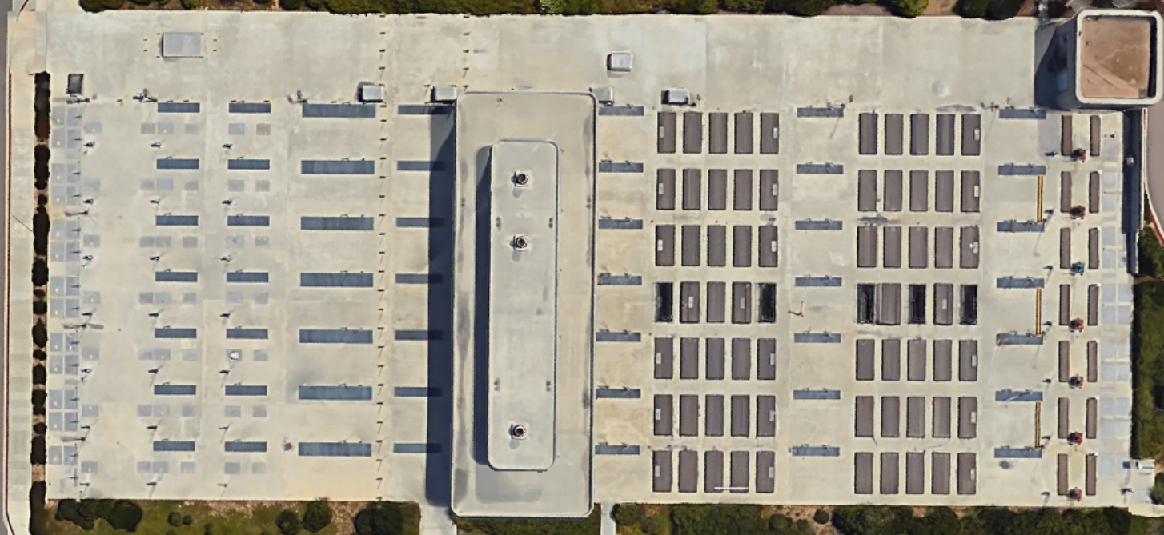
What to measure & where to install it?
sc1000
Dashboard
LDO
AMTAX
FILTRAX
SOLITAX
RAS
AMTAX
FILTRAX
PE
IRQ
AX
AX
AX
OX

Slide 10
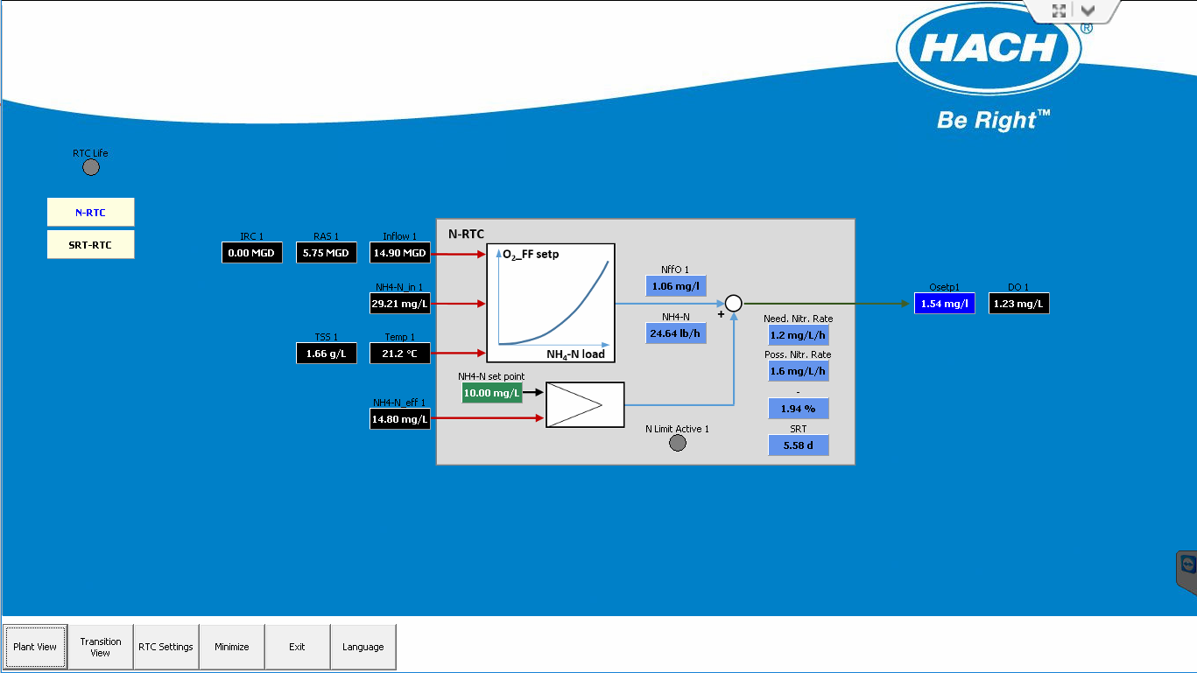
What data is available?

Slide 11
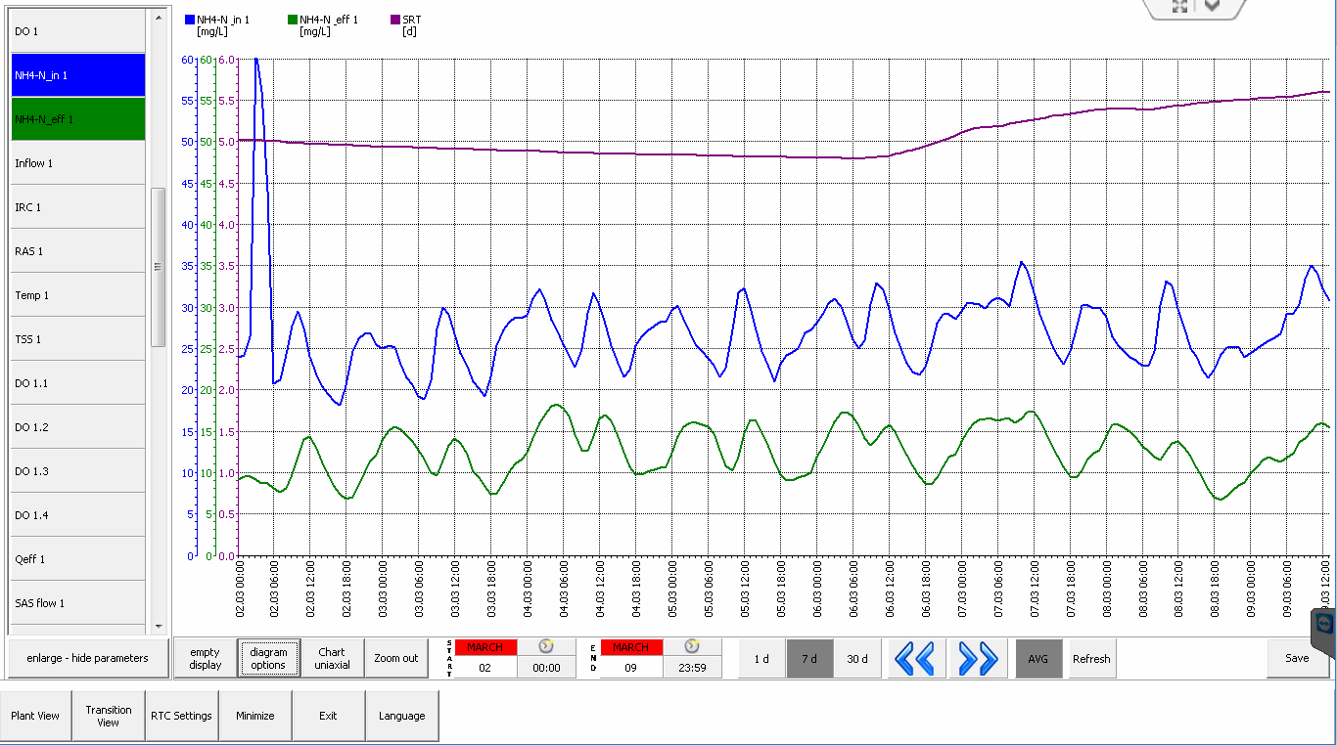
How Do we manage all the data?

Slide 12
Results from real time modelling
ABAC project now on fast track
Engineers have important design data
Expanded to South Plant

Slide 13
24 MGD A/O MICHIGAN
Aeration Tank 1: Manual Control
Aeration Tank 2: ABAC Control
15% Savings
$58,728/yr
$
$
$
$
$
$
$
$
$

Slide 14
Process management software applications for modelling or control
BOD/COD Removal
Ammonia Removal
Total Nitrogen Removal
Sludge Retention Time
Dissolved Oxygen Control
Chemical Phosphorus Removal
Sludge Thickening
Sludge Dewatering
DAF Coagulant/Polymer Control
More on the way!

Slide 15
Appendix – additional process management systems

Slide 16
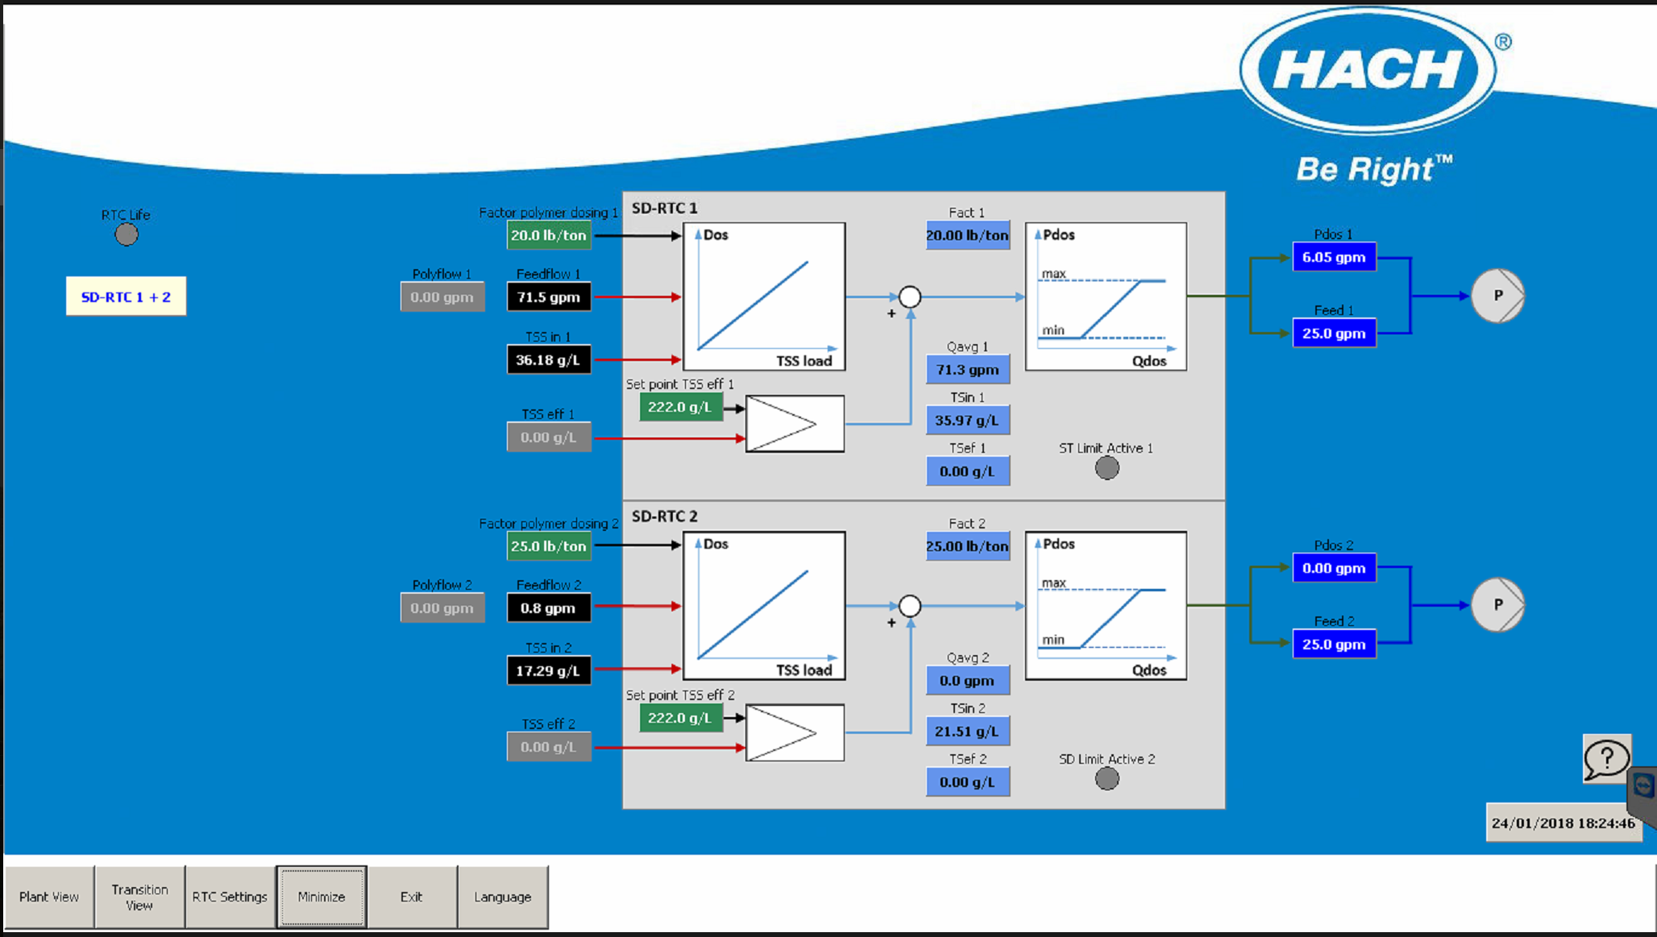
Sludge Thickening or dewatering
Lb/ton Poly Dose Setpoint
(Operator entered)
Suggested Polymer Flow Rate Setpoint
Polymer Flow Rate and Feed Sludge Flow Rate
Feed Sludge Concentration
Optional Filtrate (Feedback) TSS Setpoint
Optional Filtrate (Feedback) TSS Concentration

Slide 17
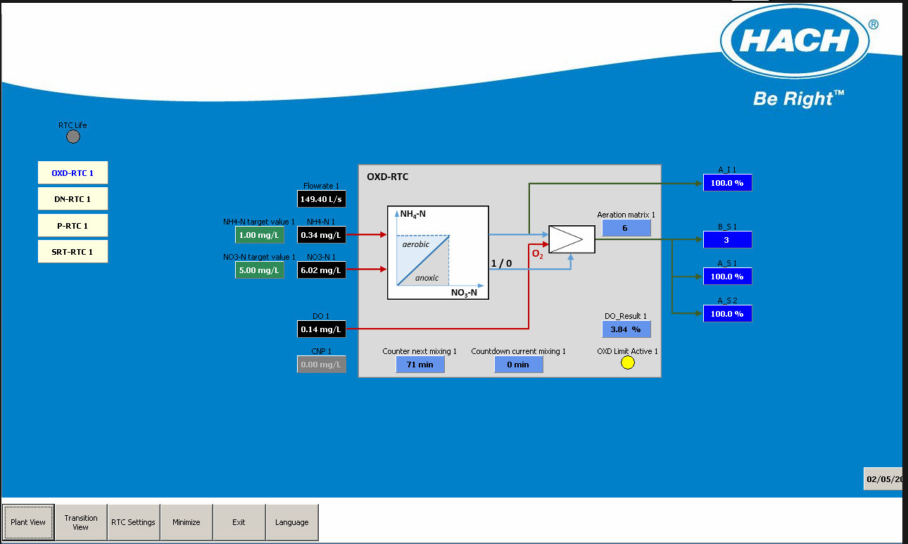
Simultaneous nitrification/dentirification
“Aeration Intensity” Suggested Setpoint (could also be DO concentration setpoint, and others)
Ammonia, Nitrate Target Values
(Operator entered)
Ammonia, Nitrate Concentrations
System can be restricted by DO limits, other input triggers

Slide 18
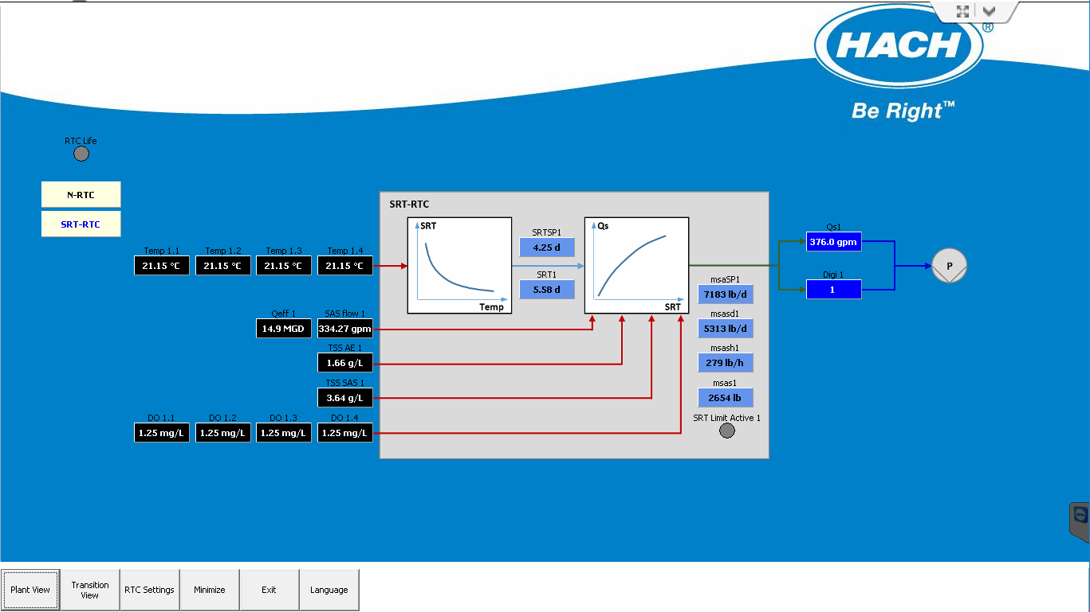
Sludge retention time
SRTSP1 = Setpoint of the appropriate SRT as determined by the RTC (temperature or lookup table)
Qs1 = Waste Activated Sludge flow rate required to meet SRT setpoint
Temperature of the Mixed Liquor (up to four inputs)
Qeff 1 = Effluent flow rate
SAS flow 1 = Waste Activated Sludge flow rate
msaSP1 = load of sludge that needs to be wasted today to meet SRT setpoint
TSS AE 1 = Mixed Liquor Solids Concentration
TSS SAS 1 = Waste Activated Sludge Solids Concentration
msasd1 = load of sludge wasted in last 24hrs
msash1 = current sludge wasting rate
DO Concentration of the aerobic volume. If less than limit value, RTC will remove the zone’s volume from the total aerobic volume
msas1 = load of sludge wasted since midnight
SRT1 = Actual SRT of the activated sludge system

